Slide 1
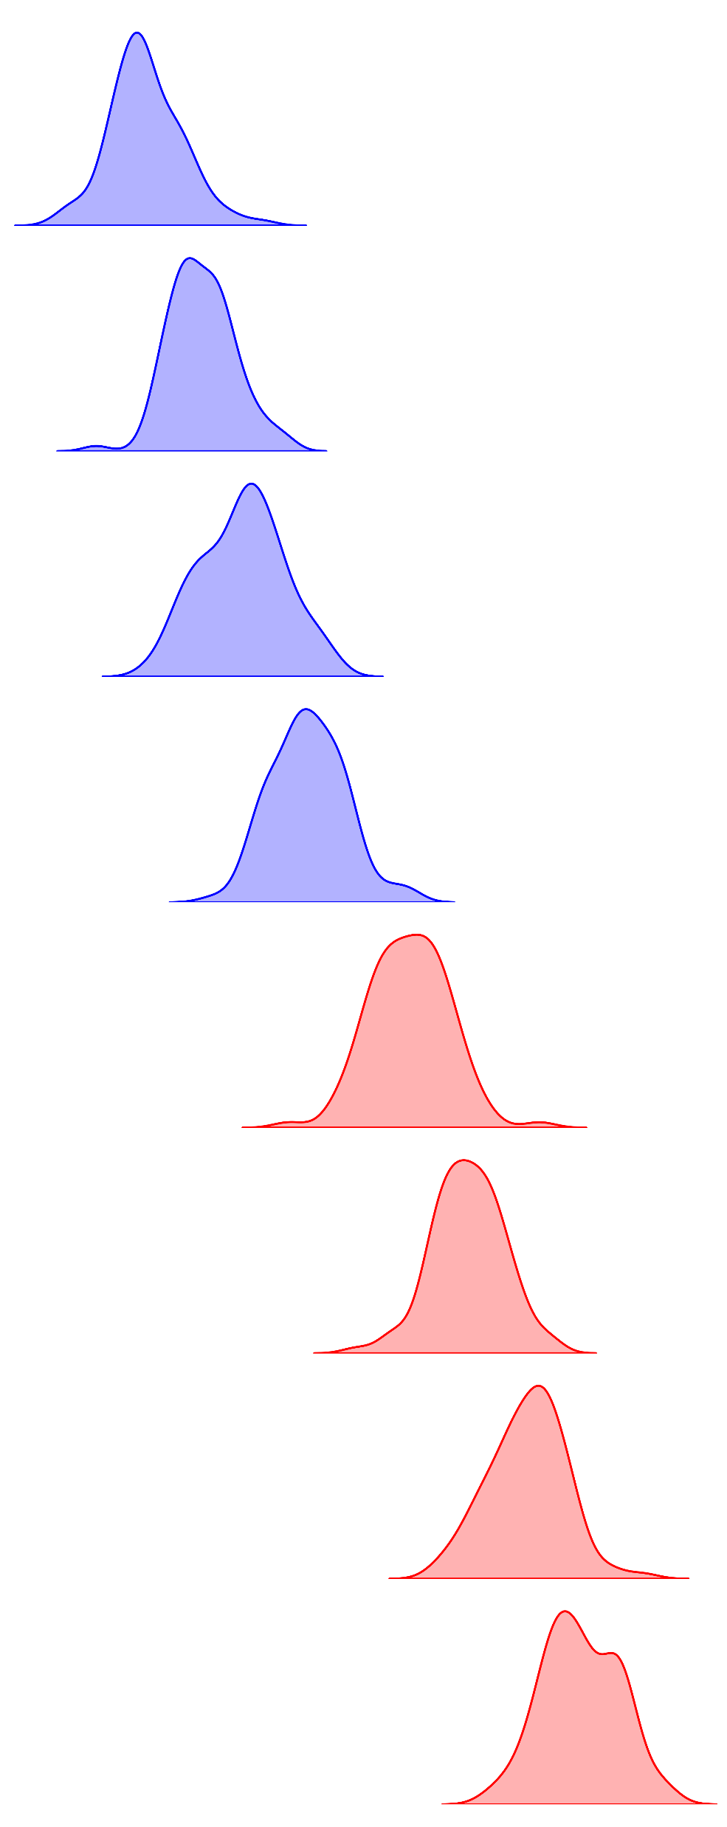
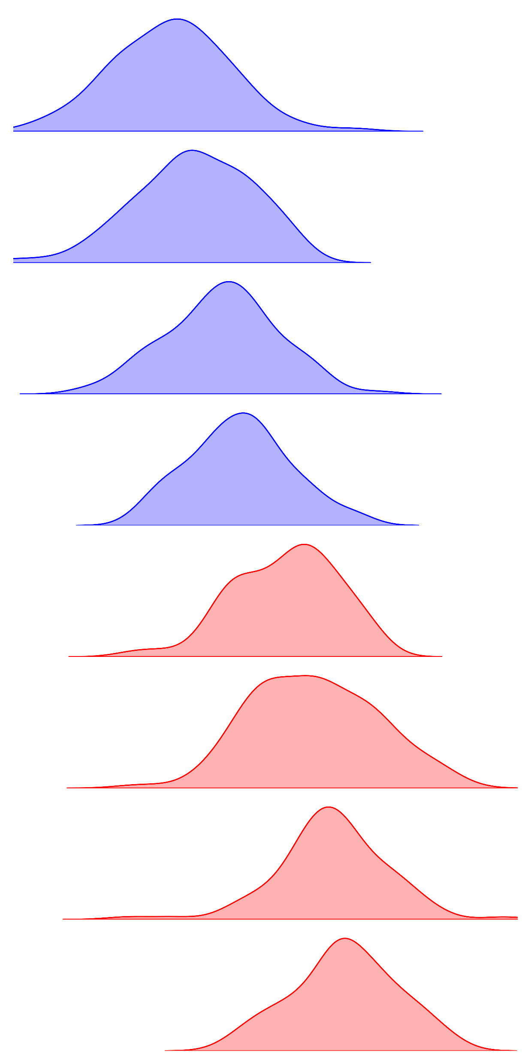
PCC
MI
NC
Sub 1
ASD
Visit 1
Sub 2
Visit 2
Sub 3
PCC
Acc.: 100%
Sub 4
Acc.: 87.5%
MI
Sub 5
Acc.: 87.5%
Acc.: 50%
Sub 6
Sub 7
Sub 8

Slide 2
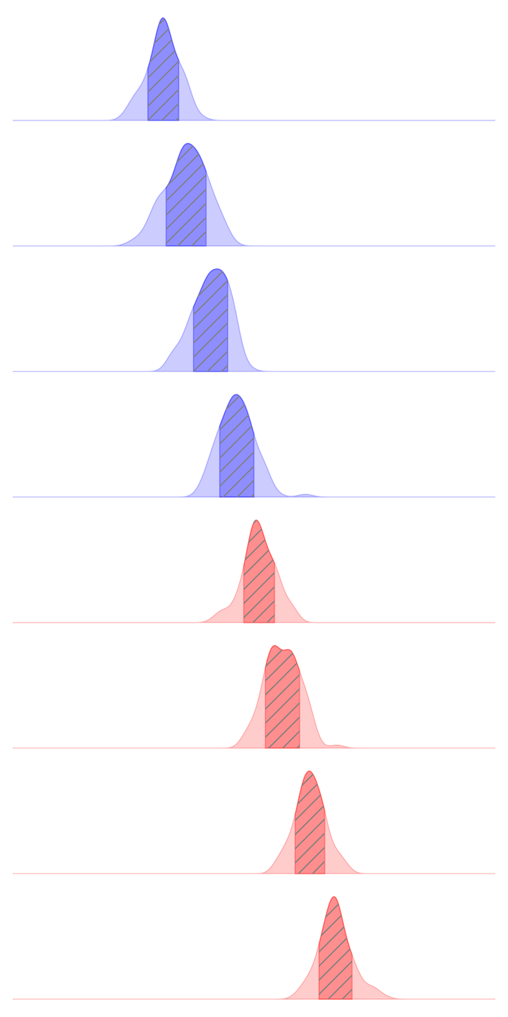
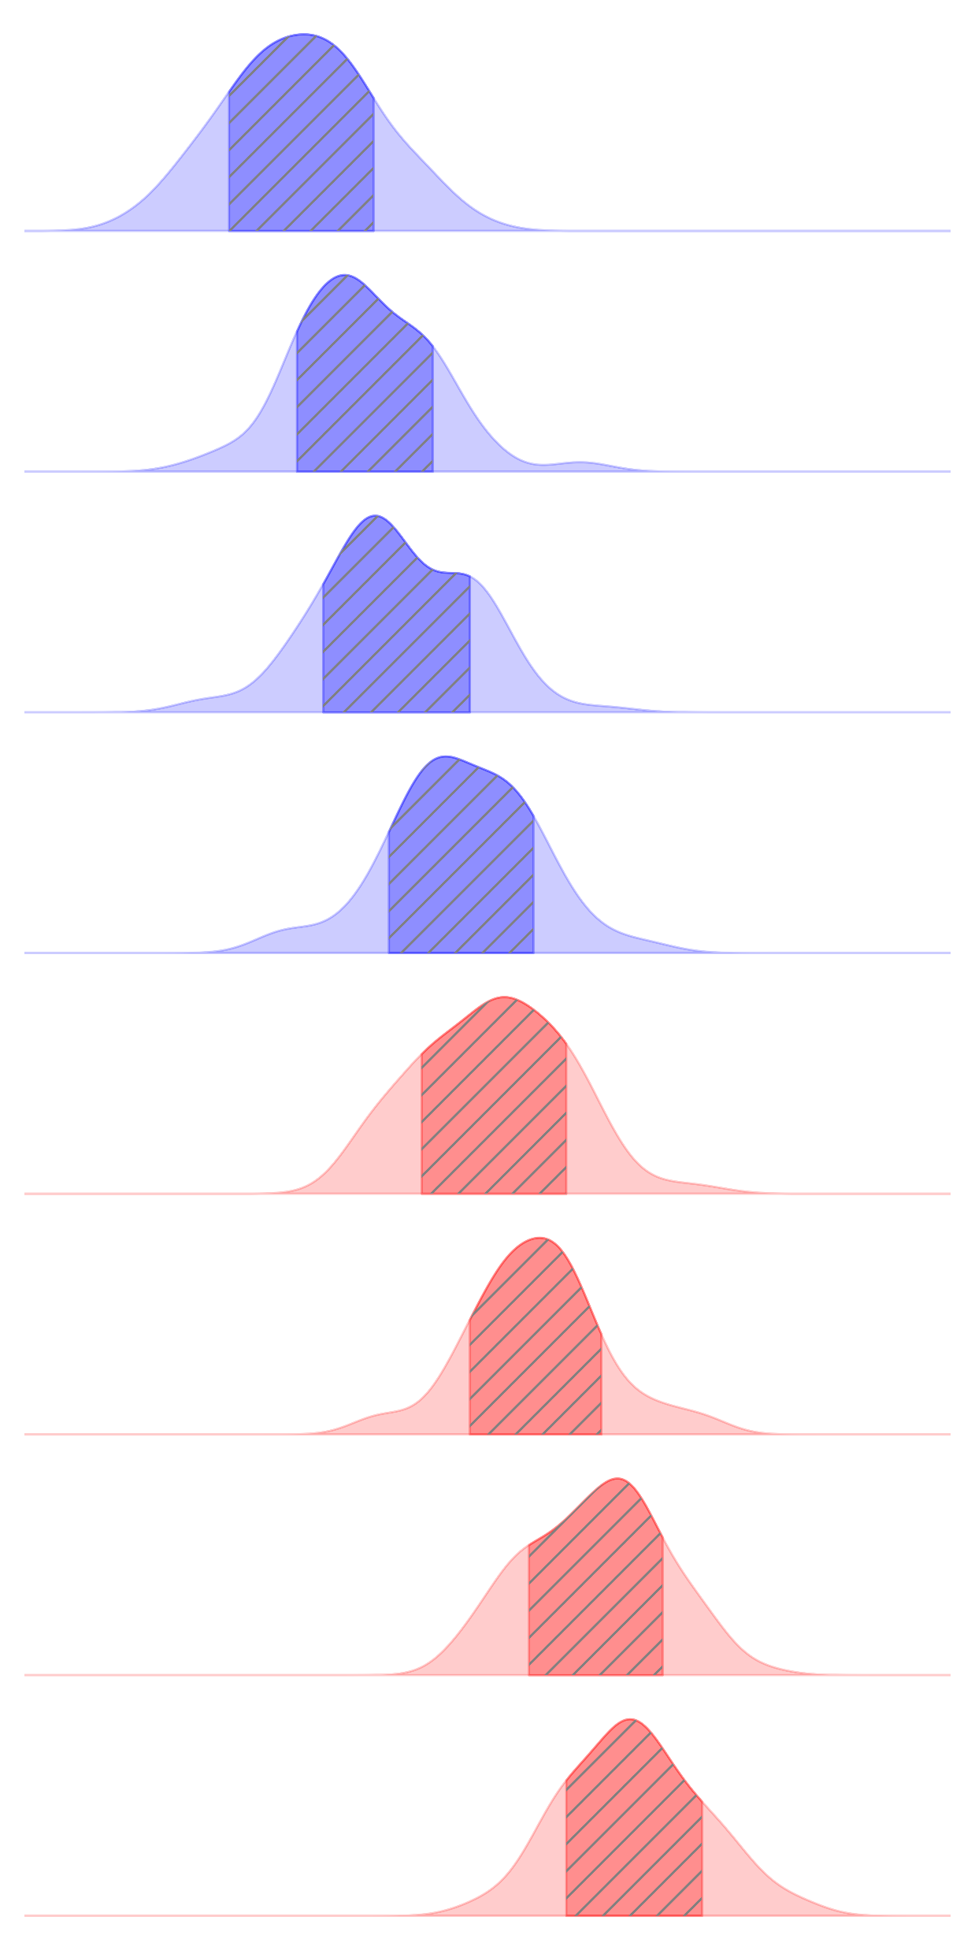
PCC
MI
NC 1
NC 2
NC 3
NC 4
ASD 1
ASD 2
ASD 3
ASD 4

Slide 3
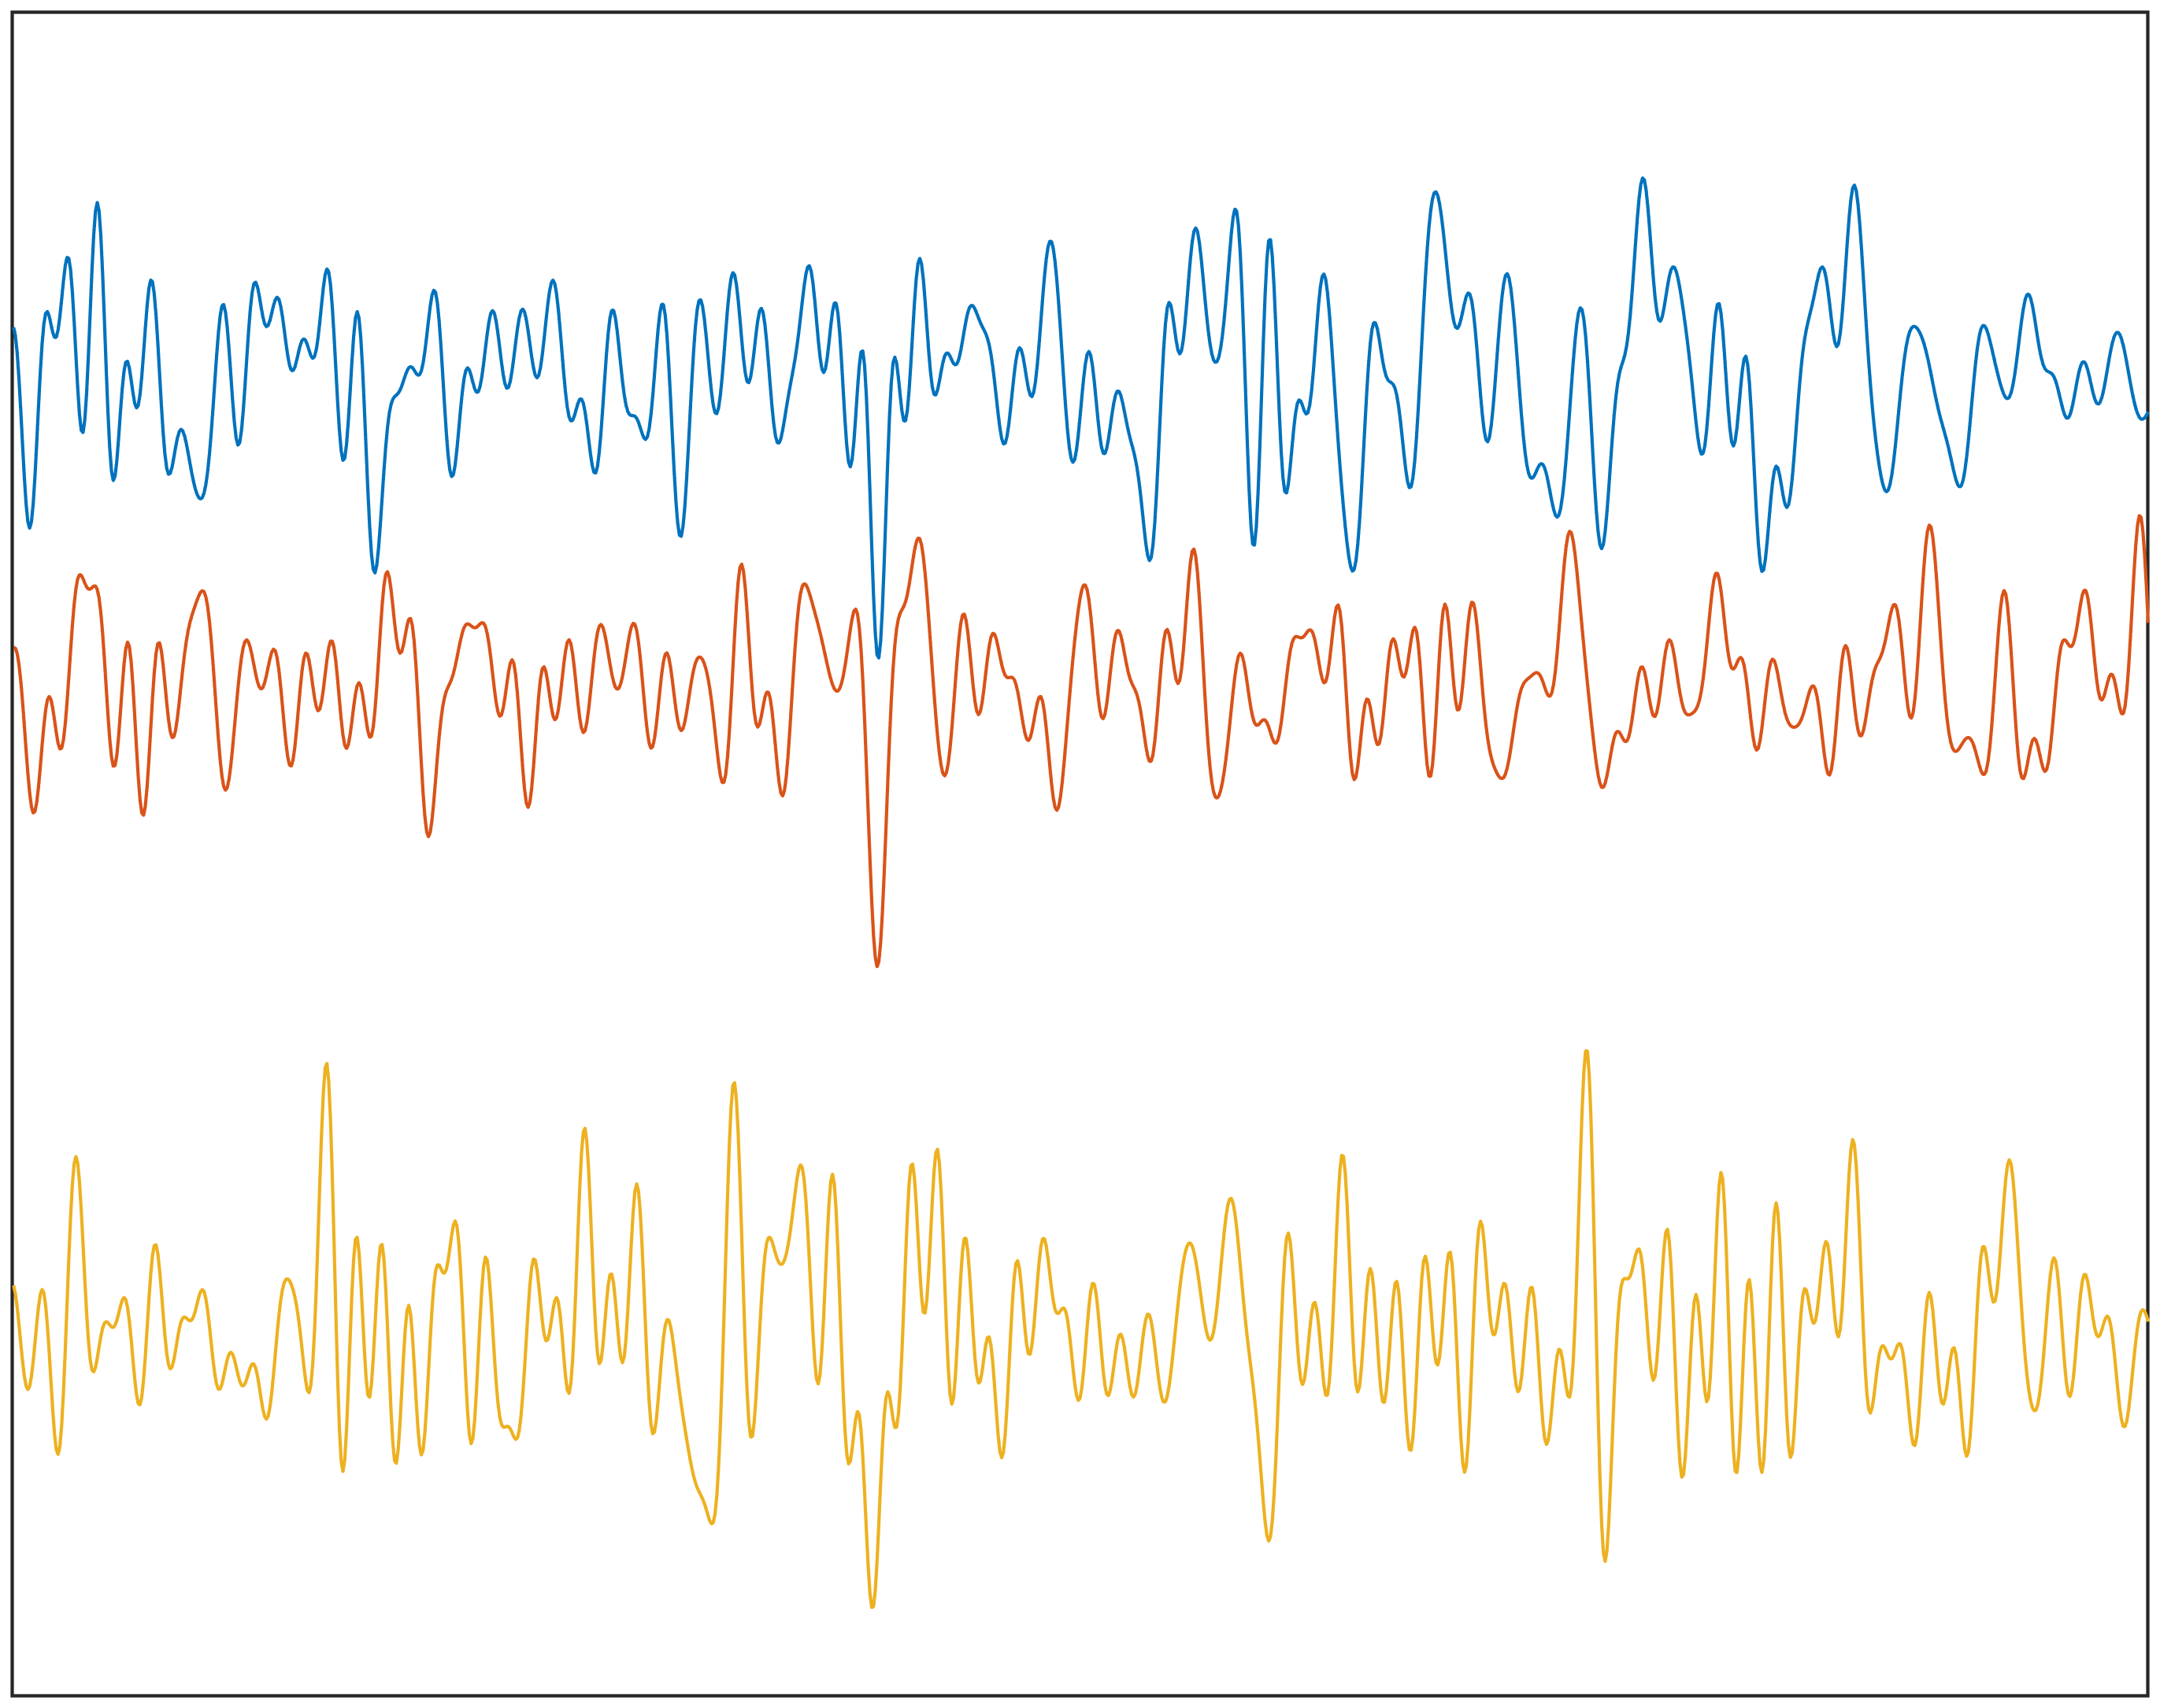
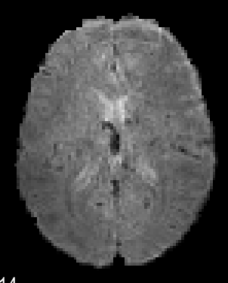
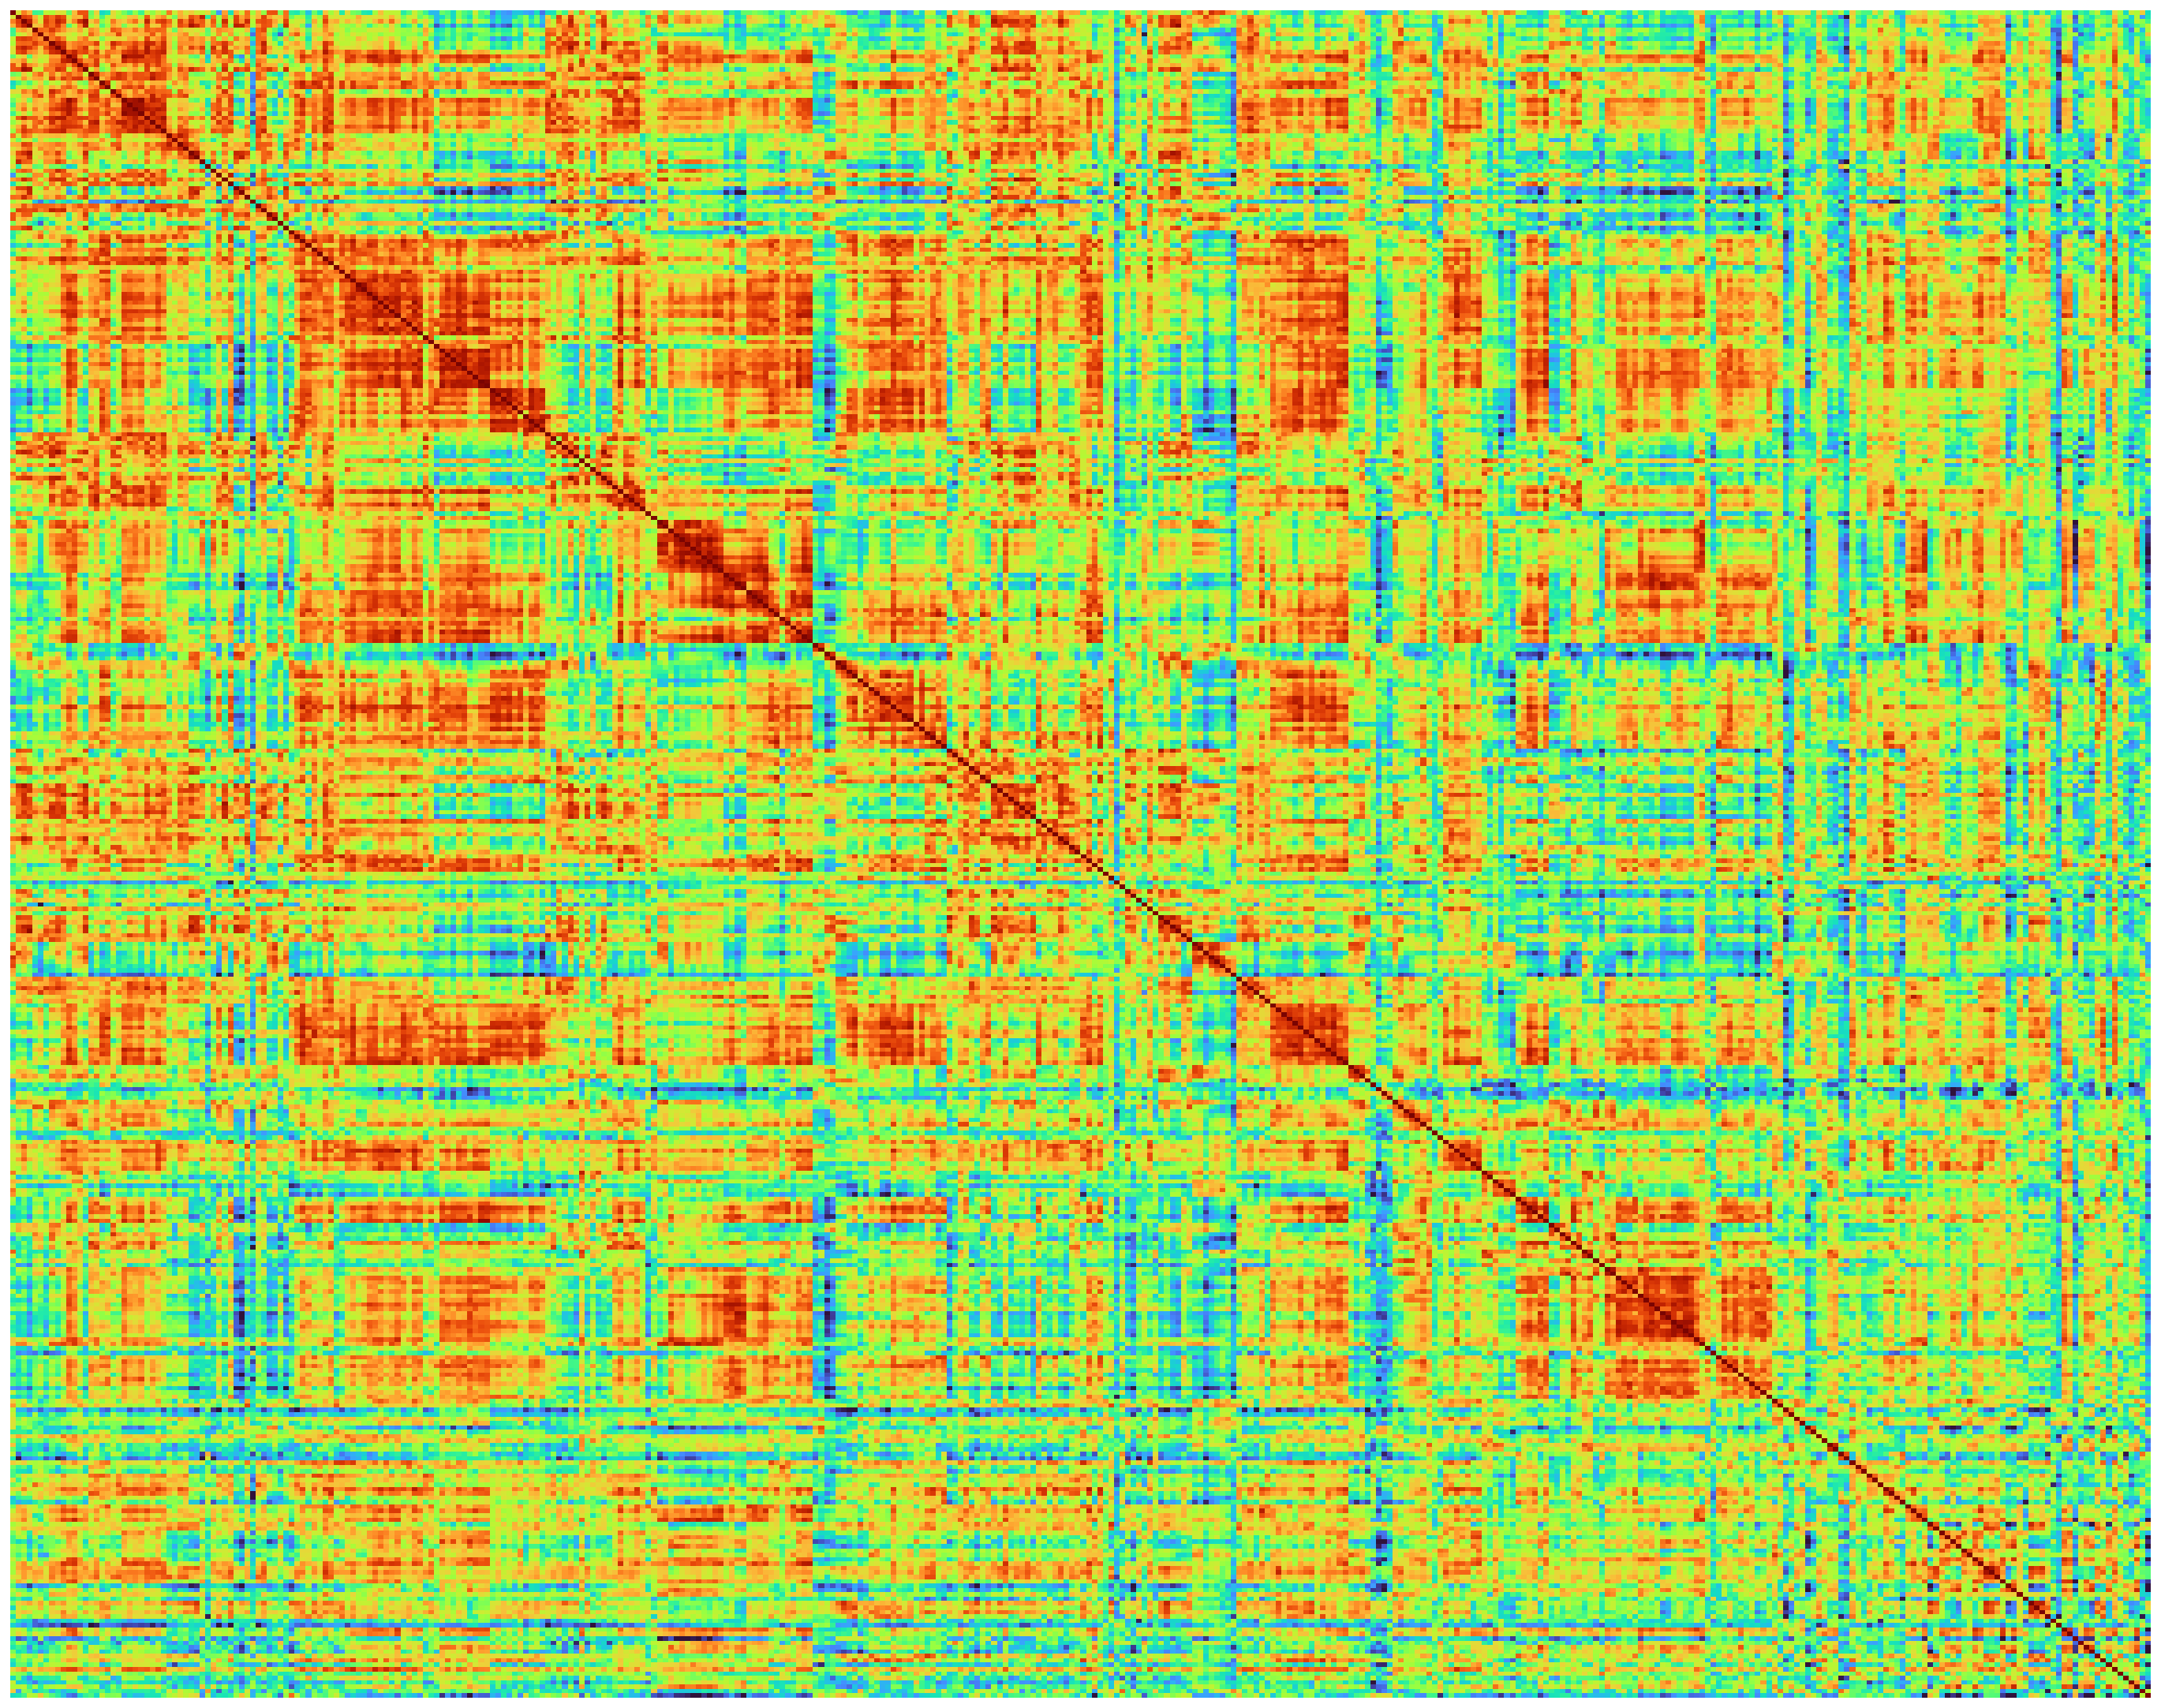
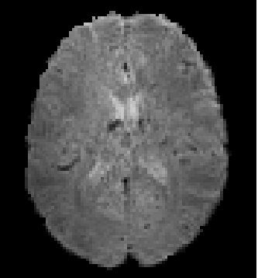
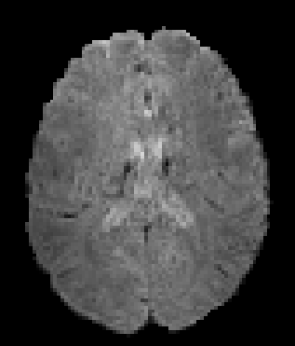
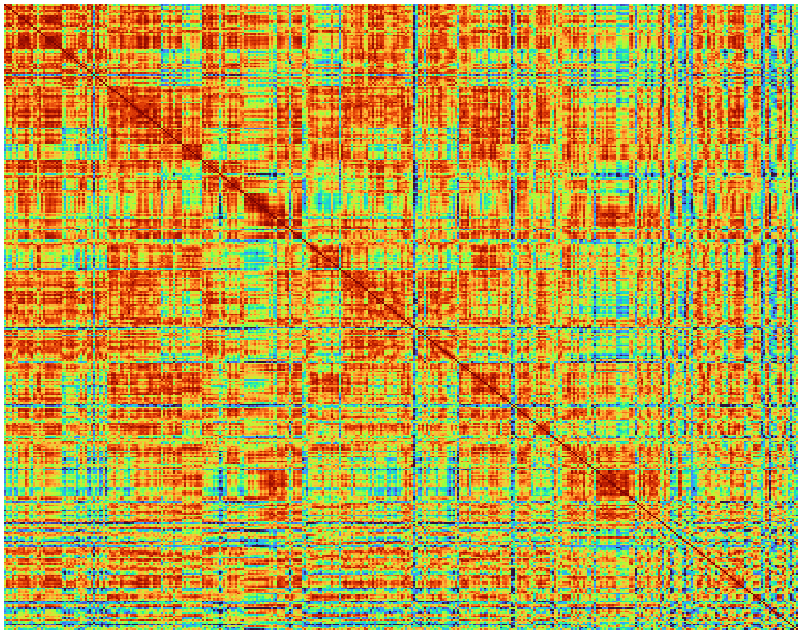
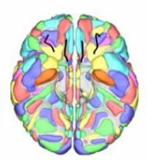


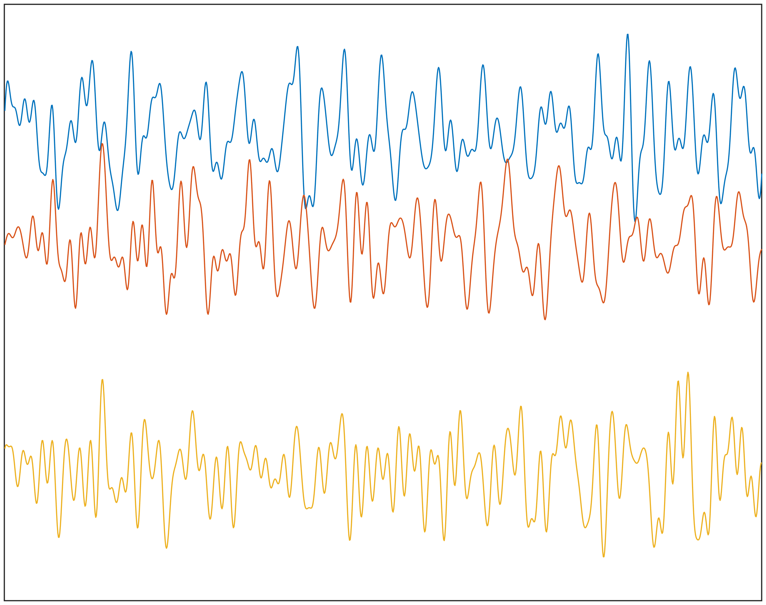
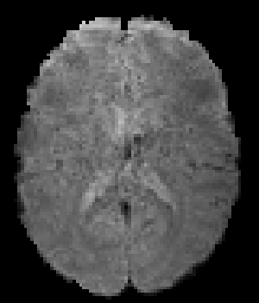
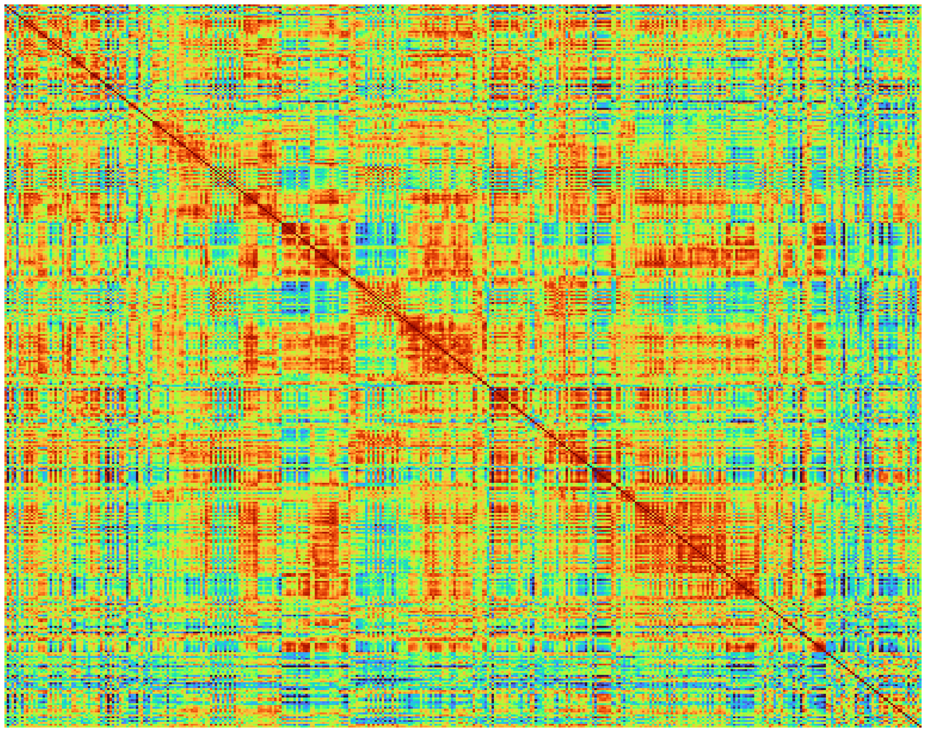
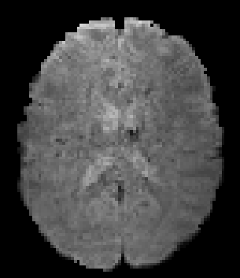
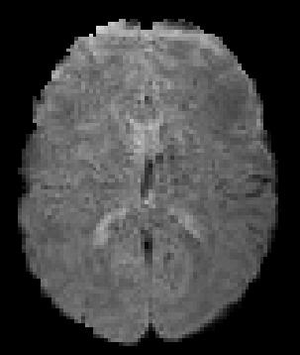
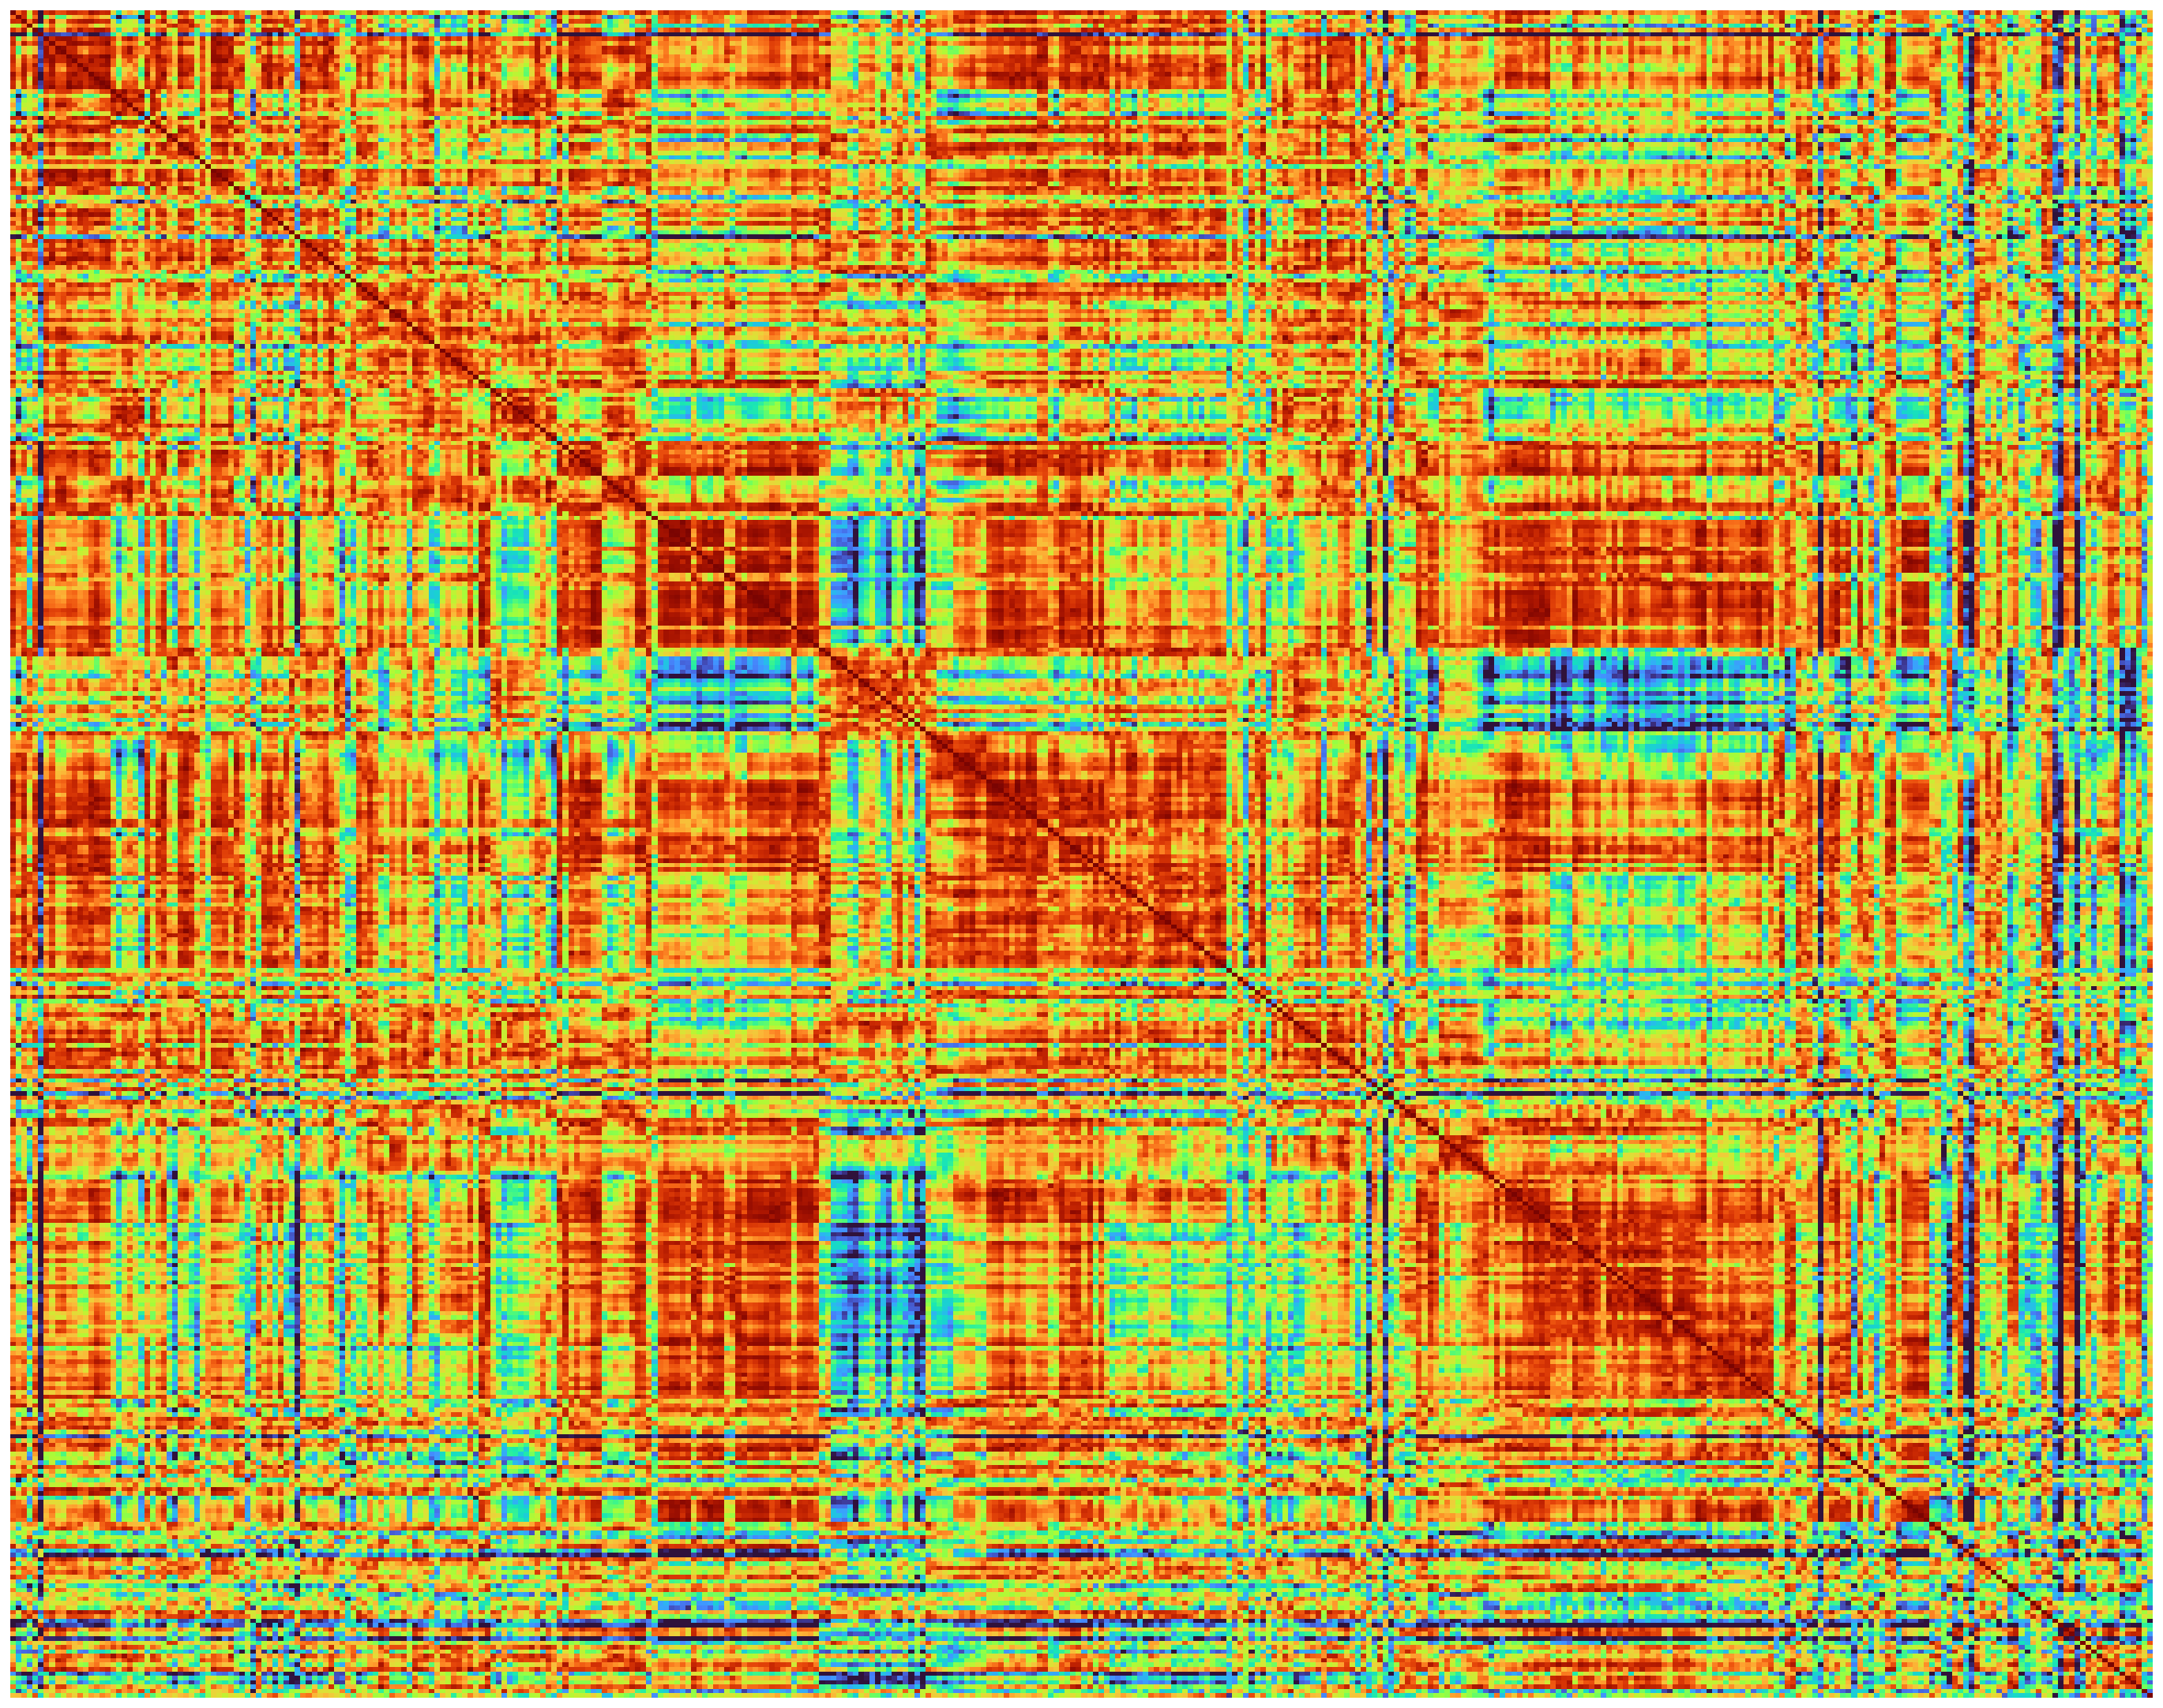





TE
R×T
Subject 1
$\hat{R}$× K
$\hat{R}$ × $\hat{R}$
ROI 1
CS
ROI 2
.
1D-CNN-Transformer
Encoder
.
Time
.
CS
AICHA
Rs-fMRI
ROI R
:
Maximize
AAL
Shared weights
Minimize
Subject 2
ROI 1
CS
ROI 2
.
1D-CNN-Transformer
Encoder
.
Time
.
CS
Rs-fMRI
ROI R
T
K
1D-Conv
1D-Conv
K input tokens of shape $\hat{ R}$×1
K output tokens of shape $\hat{R}$×1
1D-Conv
.
R
.
Trainable Positional Encoding
.
.
.
.
.
.
.
Transformer
.
R
.
.
.
.
.
.
1D-Conv
R_{add}
1D-Conv
$$\hat{R}=R+$$
R_{add}

Slide 4
Training Data
Validation Data
N_{val} subjects
2 sessions/subject
Hyperparameters
1st pos.
10th pos.
ROI 1
L_{w1}=30
TPE Optimizer
VarCoNet-V2
Training
ROI 2
L_{w2}=175
L_{w3}=320
ROI R
w₁
w₂
w₃
10 × N_{val}×30
10 × N_{val}×175
10 × N_{val}×320
Sess. 1
At each epoch
10 × N_{val}×30
10 × N_{val}×175
10 × N_{val}×320
Sess. 2
L_{w1}-L_{w2}
L_{w1}-L_{w2}
L_{w1}-L_{w3}
L_{w2}-L_{w3}
L_{w3}-L_{w3}
Max obj. func. across epochs
L_{w2}-L_{w2}
1
Sess. 1
Sess. 2
2
10 × N_{val}×R(R-1)/2
SF
10 × N_{val}×R(R-1)/2
.
SF: subject fingerprinting with N_{val} subjects performed 10 times
.
.
10 × N_{val}× R(R-1)/2
10 × N_{val}× R(R-1)/2
10
10 × N_{val}× R(R-1)/2
10 × N_{val}× R(R-1)/2
mean
Obj. func. = mean + minimum

Slide 5
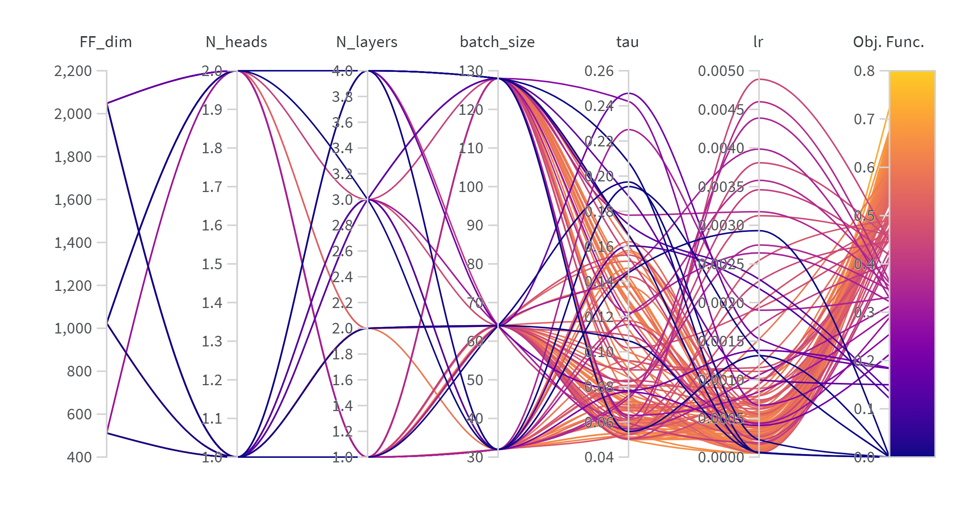
FF_{dim}
N_{heads}
N_{layers}
batch size
τ
lr
Obj. Func.

Slide 6
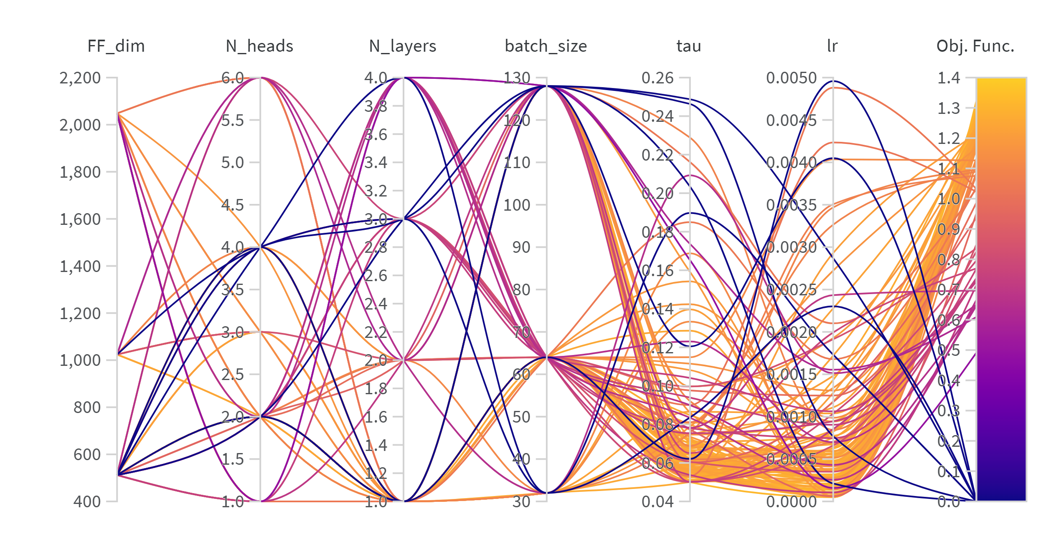
FF_{dim}
N_{heads}
N_{layers}
batch size
τ
lr
Obj. Func.

Slide 7
TE
R×T
Subject 1
R × K
R × R
ROI 1
CS
ROI 2
.
1D-CNN-Transformer
Encoder
.
Time
.
CS
AICHA
Rs-fMRI
ROI R
:
Maximize
AAL
Shared weights
Minimize
Subject 2
ROI 1
CS
ROI 2
.
1D-CNN-Transformer
Encoder
.
Time
.
CS
Rs-fMRI
ROI R
CS: Cosine Similarity
T
K
1D-Conv
1D-Conv
K input tokens of shape R×1
K output tokens of shape R×1
1D-Conv
.
.
Trainable Positional Encoding
.
.
.
.
.
.
.
Transformer
.
R
.
R
.
.
.
.
.
1D-Conv
1D-Conv

Slide 8
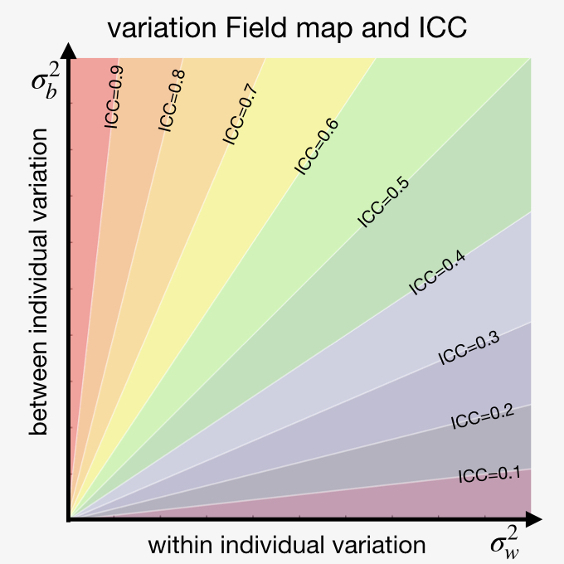
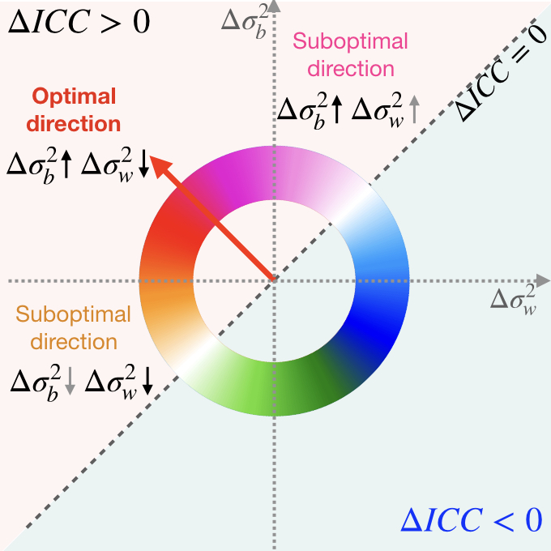

Slide 9
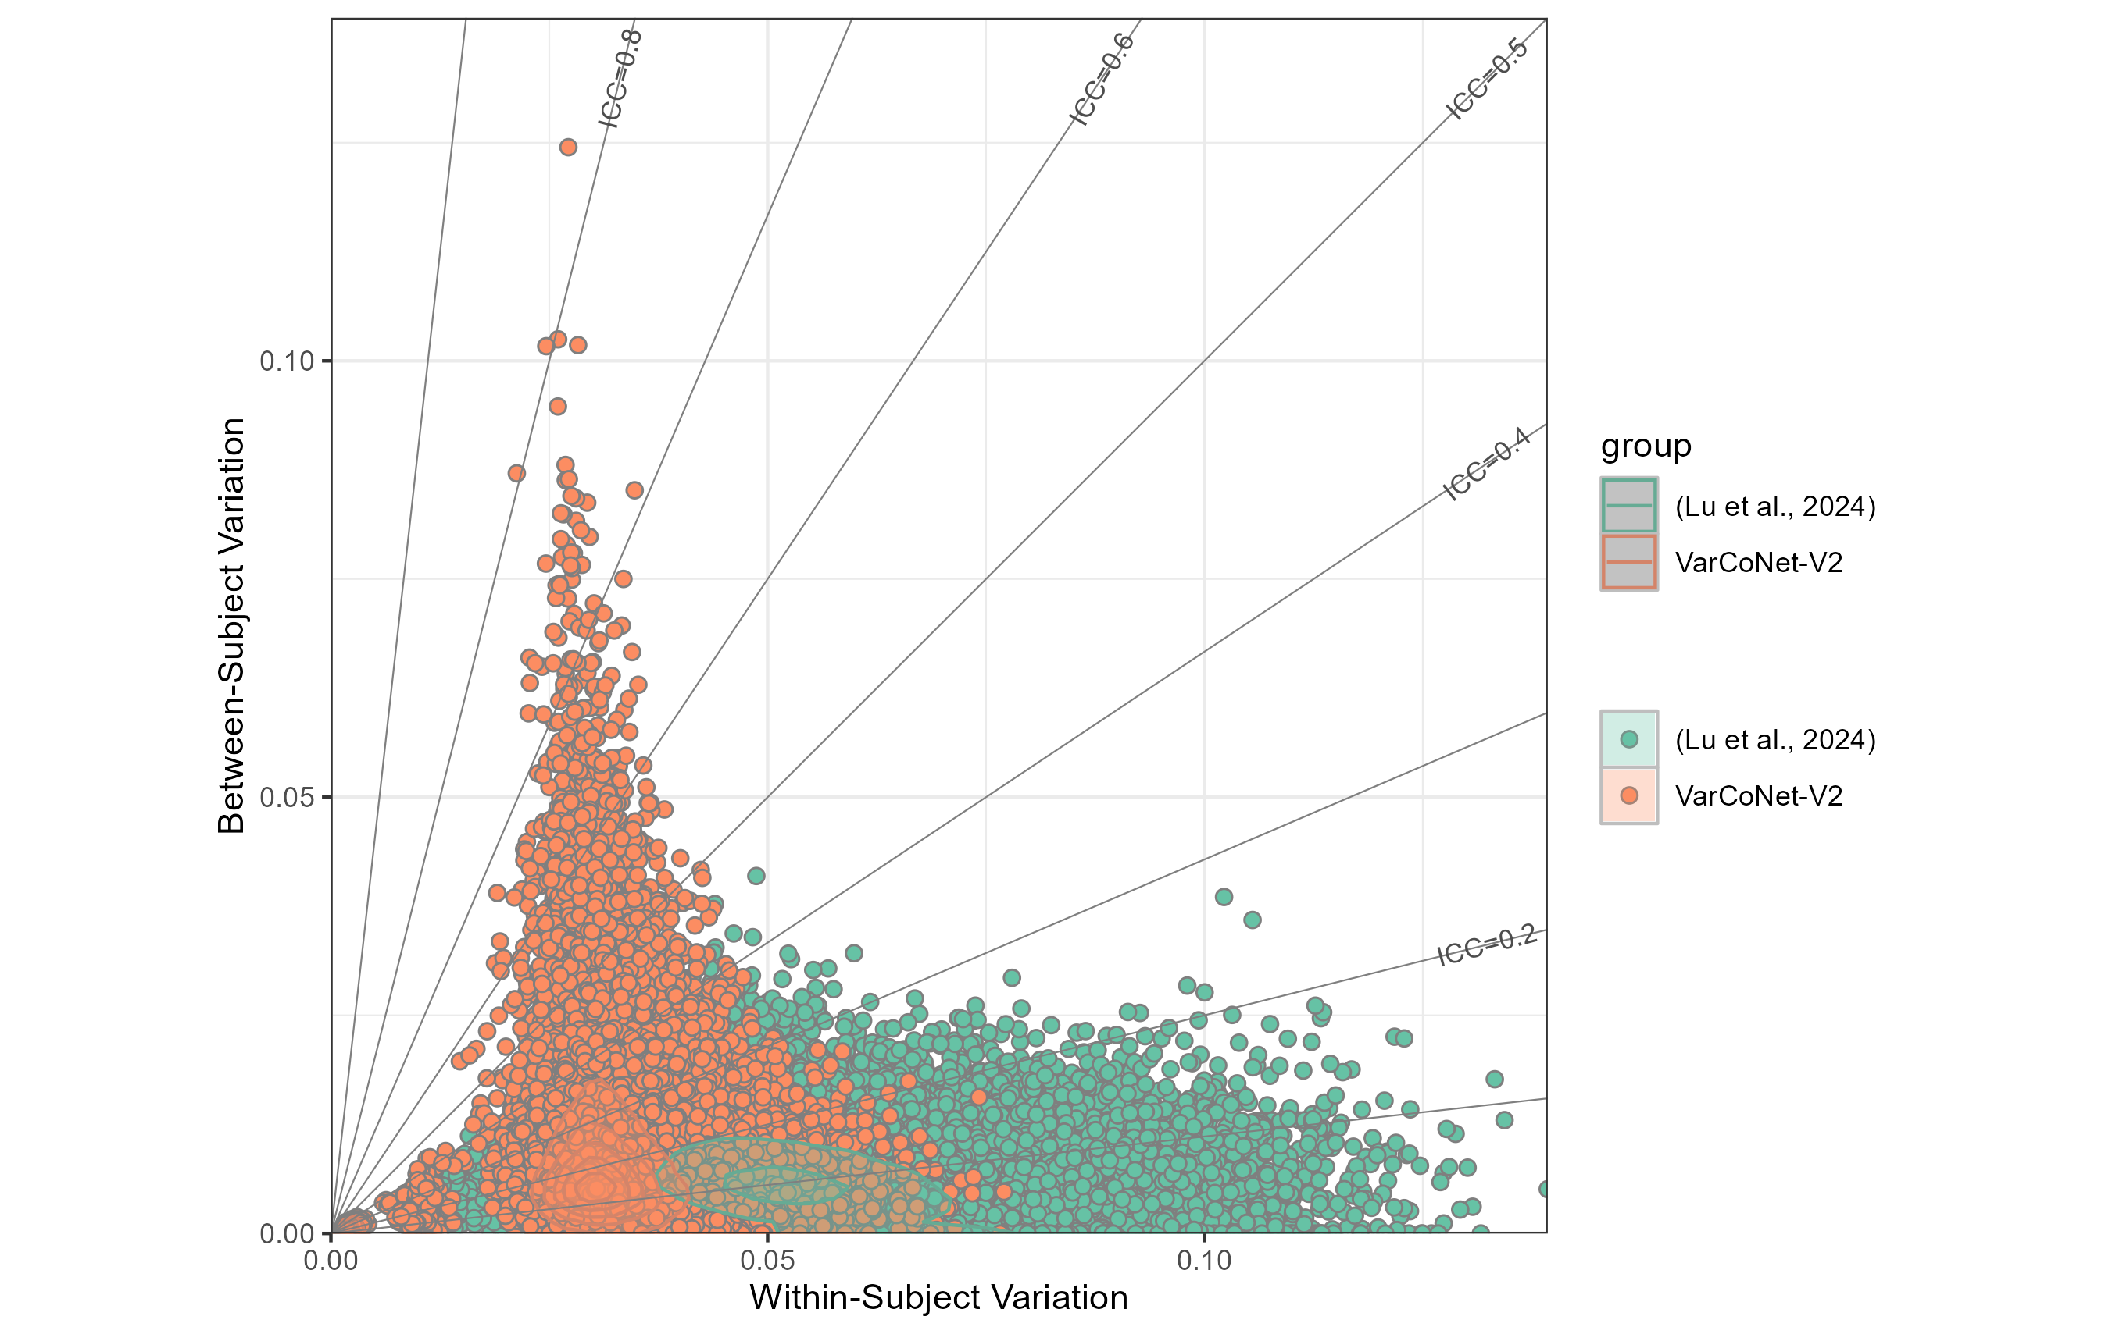
Between-Subject Variation
Within-Subject Variation

Slide 10
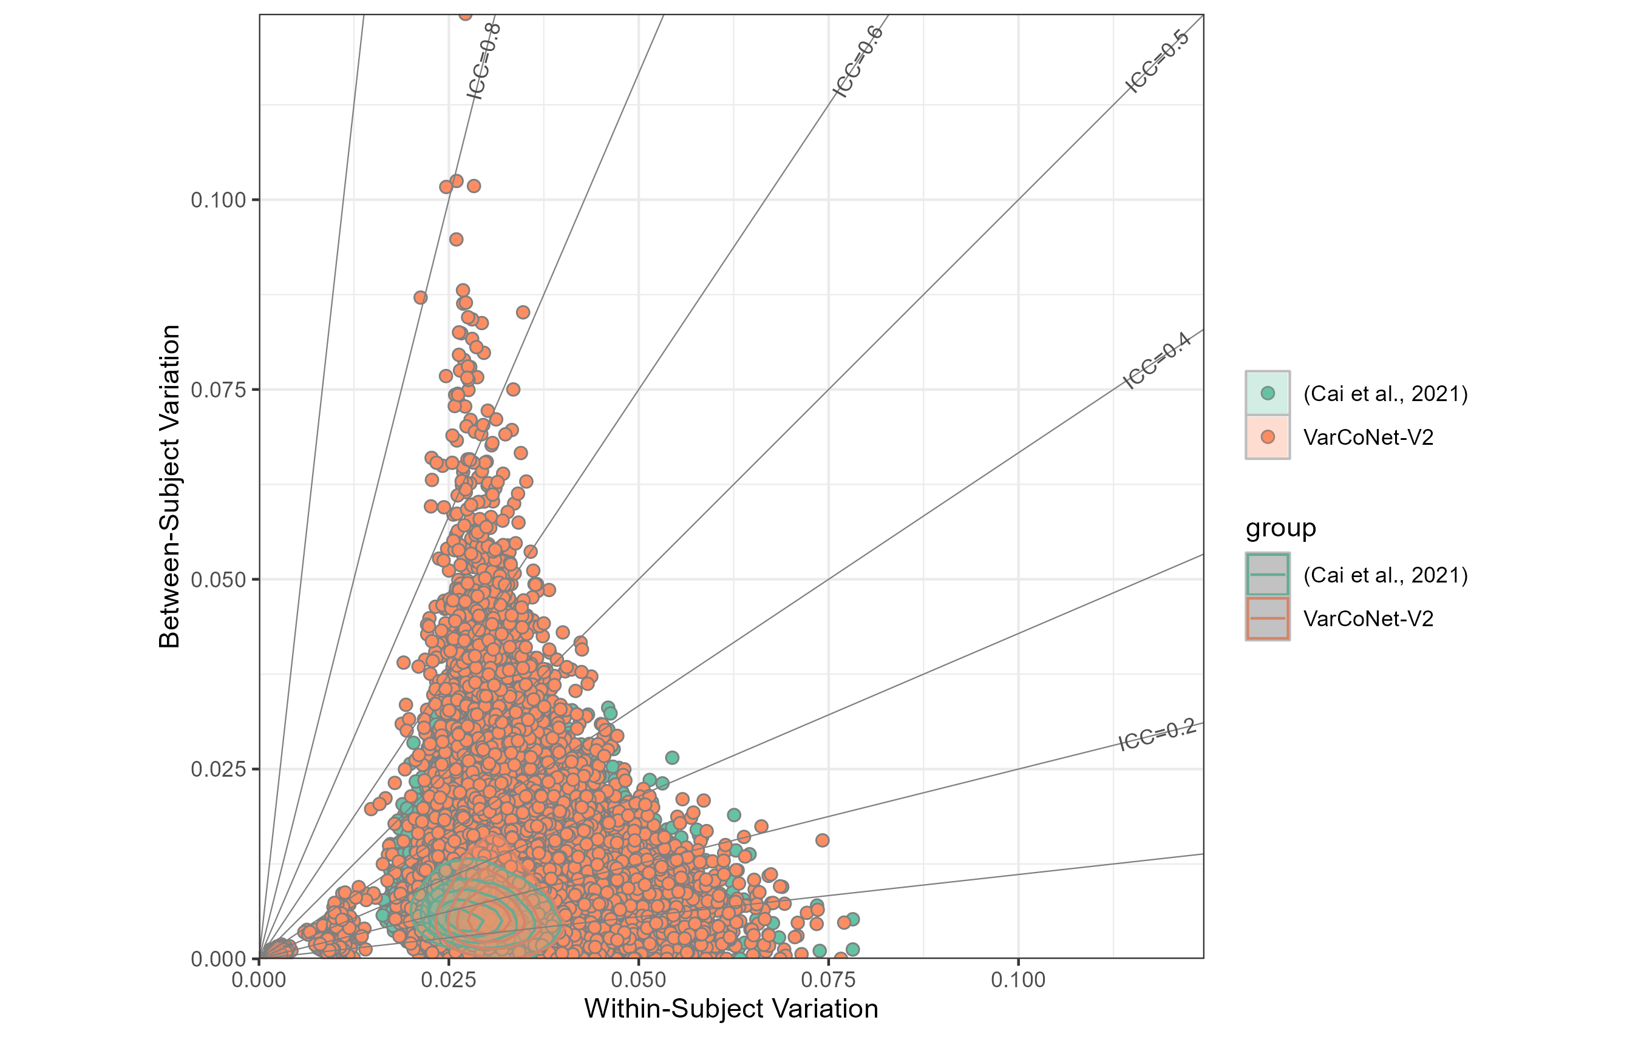
Between-Subject Variation
Within-Subject Variation

Slide 11
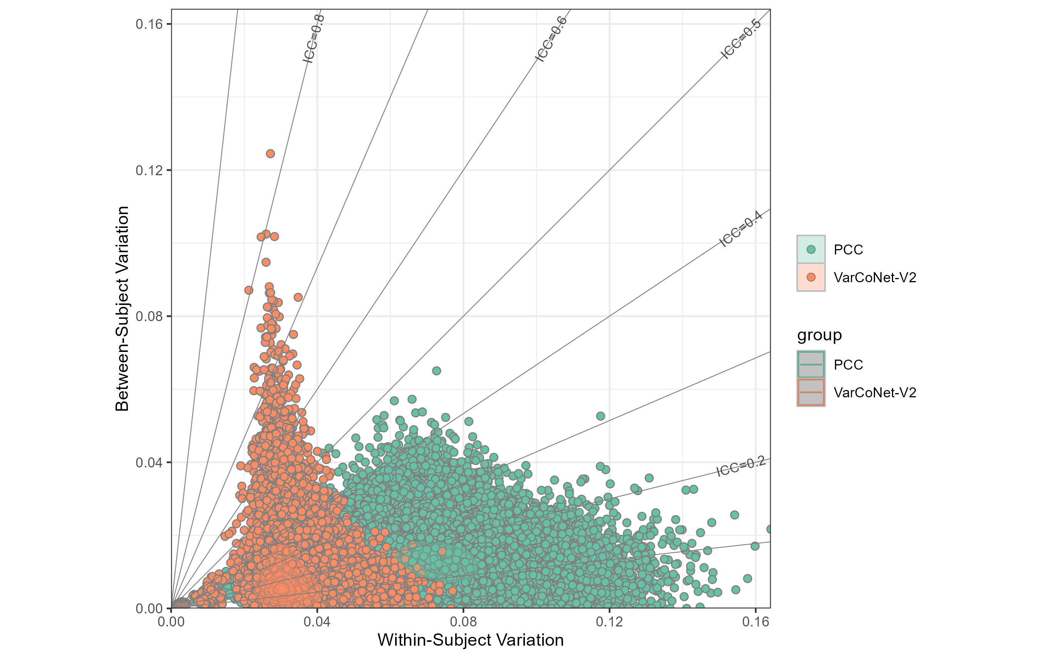
Between-Subject Variation
Within-Subject Variation

Slide 12
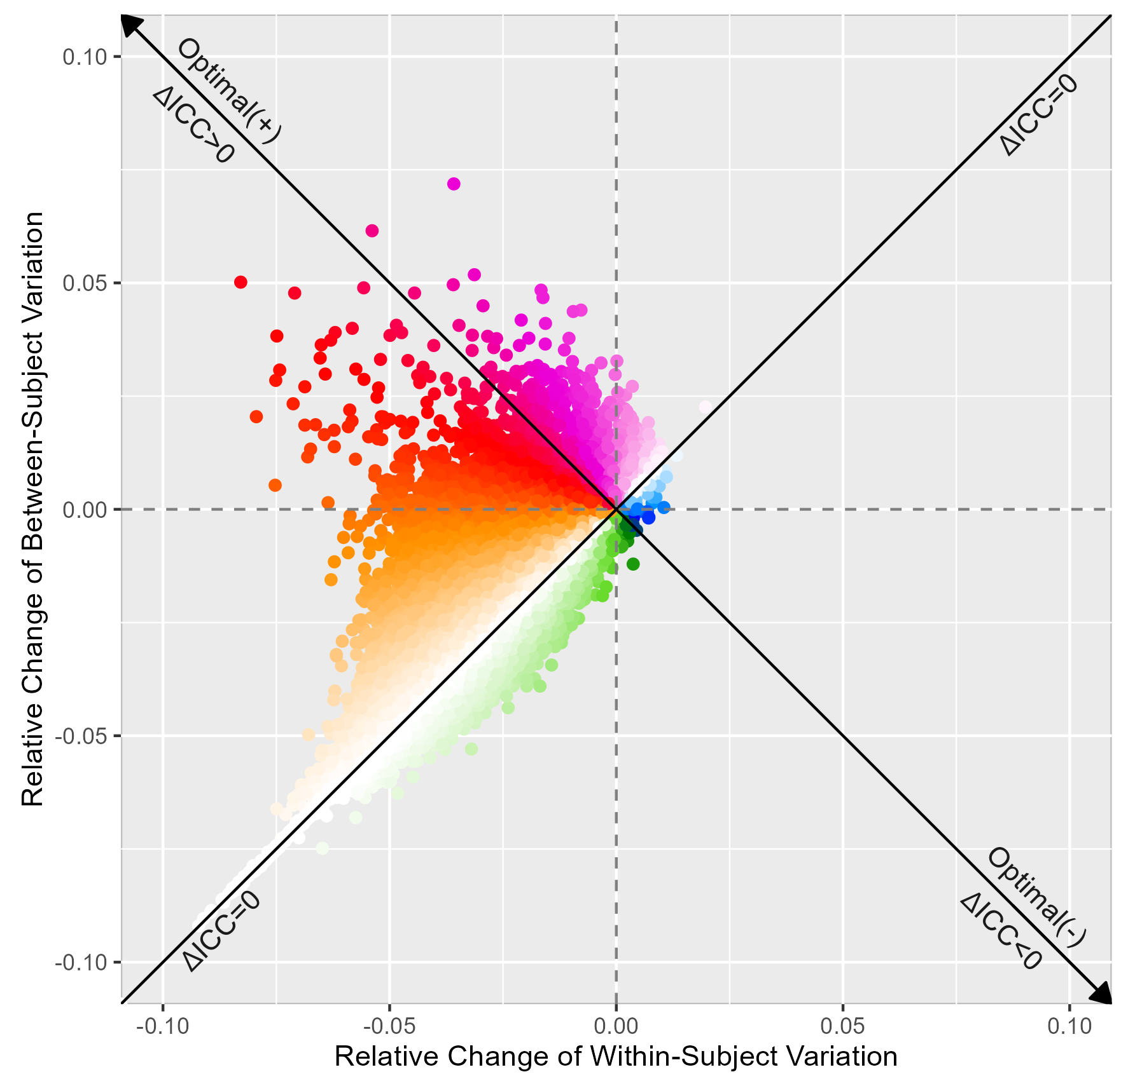
Relative Change of Between-Subject Variation
Relative Change of Within-Subject Variation

Slide 13
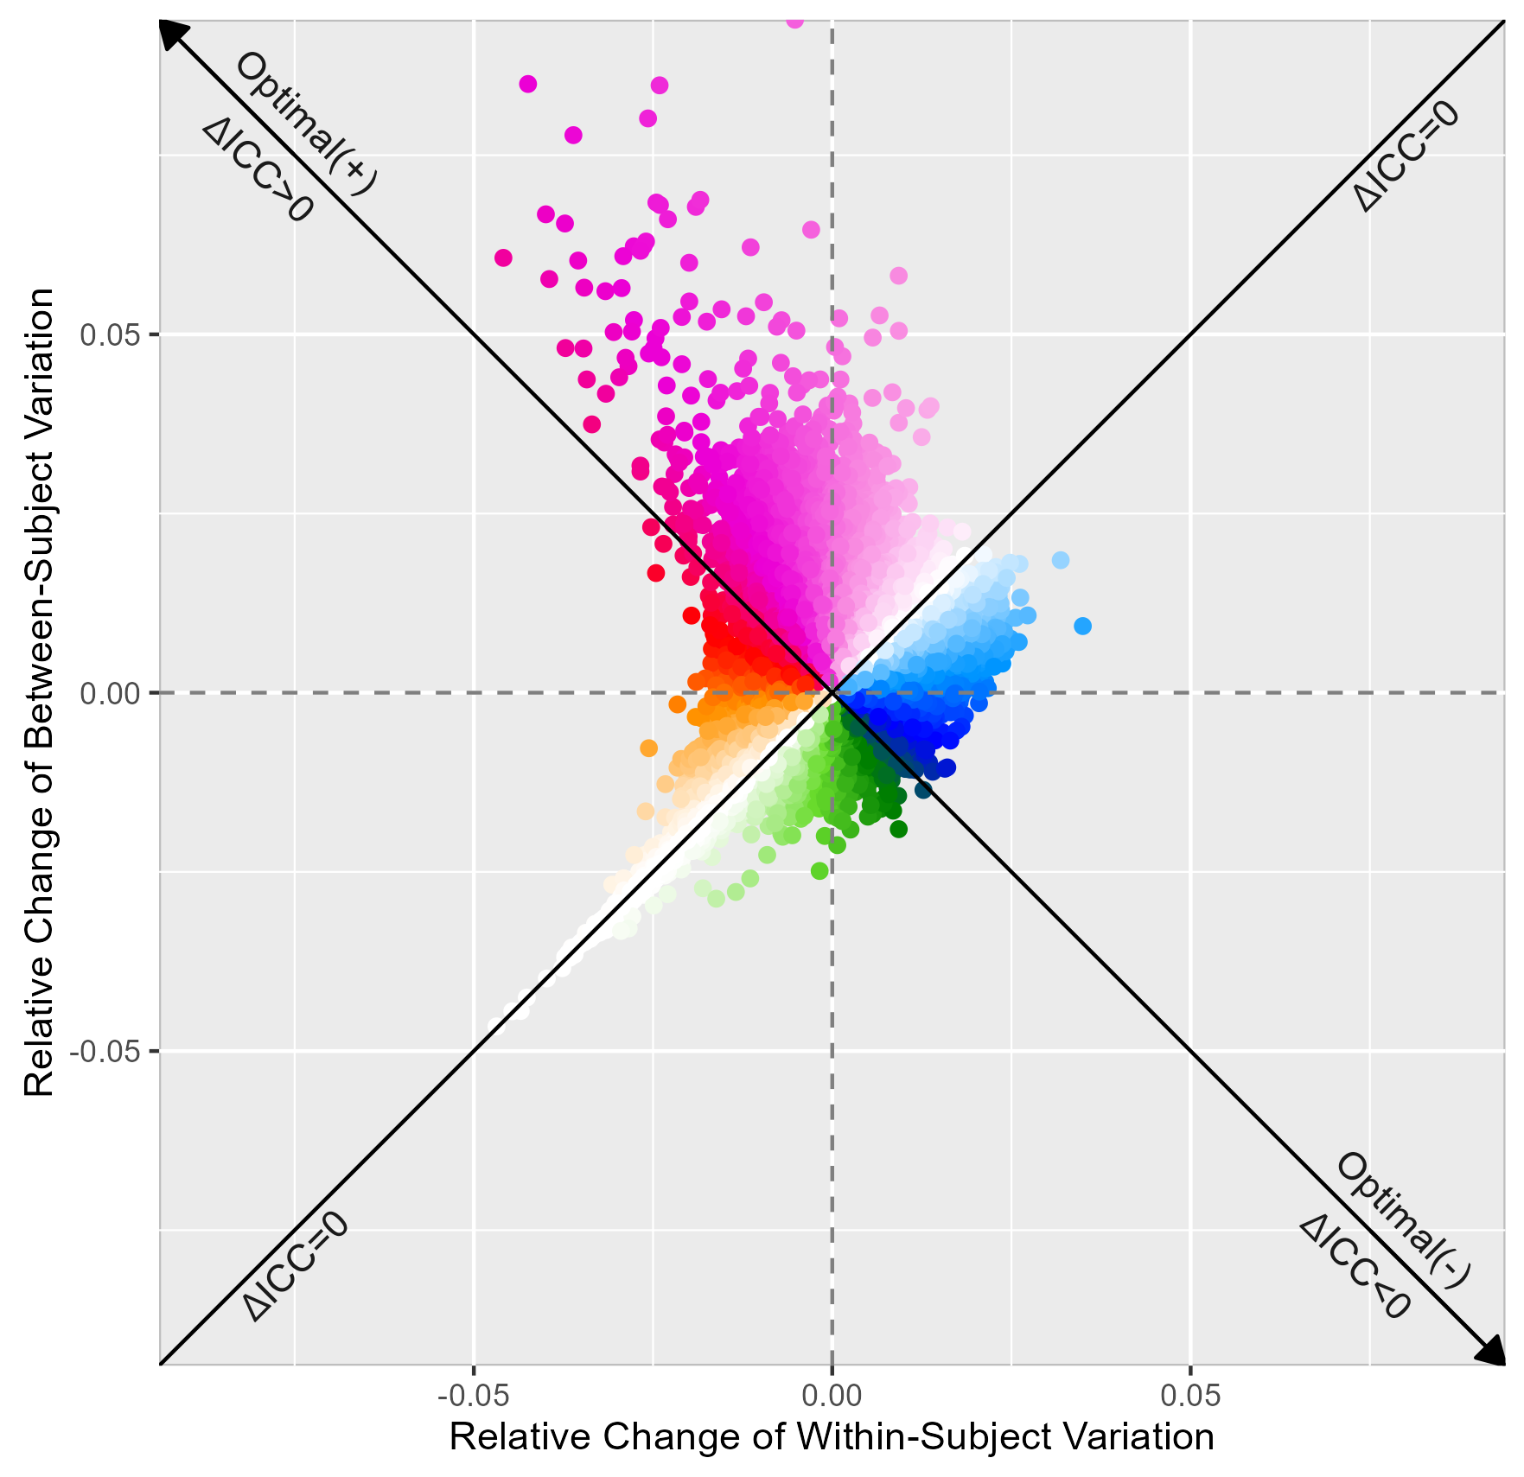
Relative Change of Between-Subject Variation
Relative Change of Within-Subject Variation

Slide 14
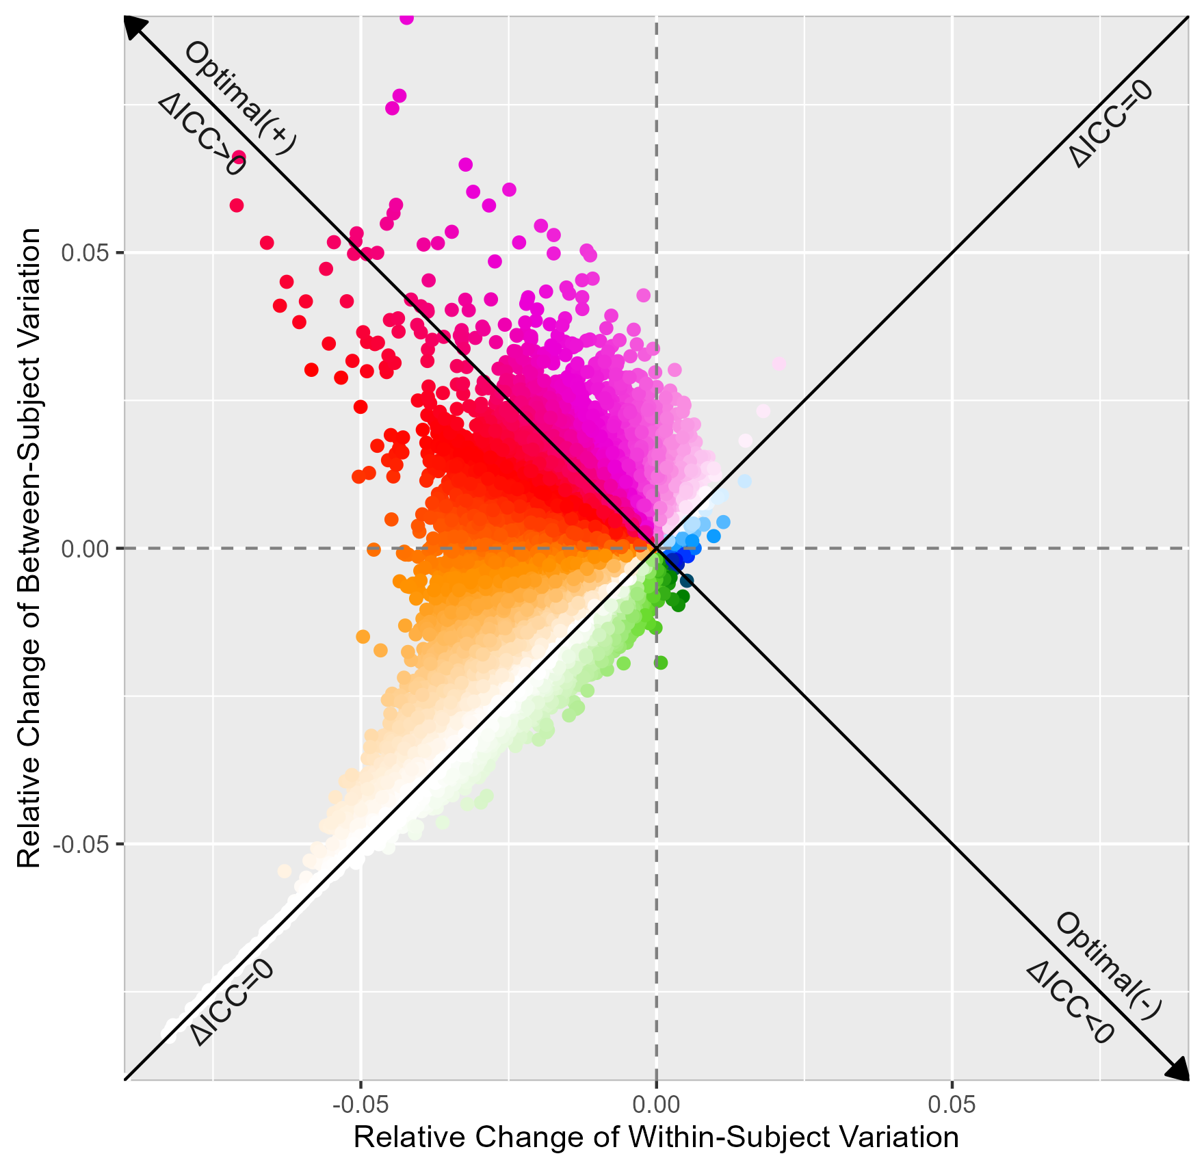
Relative Change of Between-Subject Variation
Relative Change of Within-Subject Variation

Slide 15
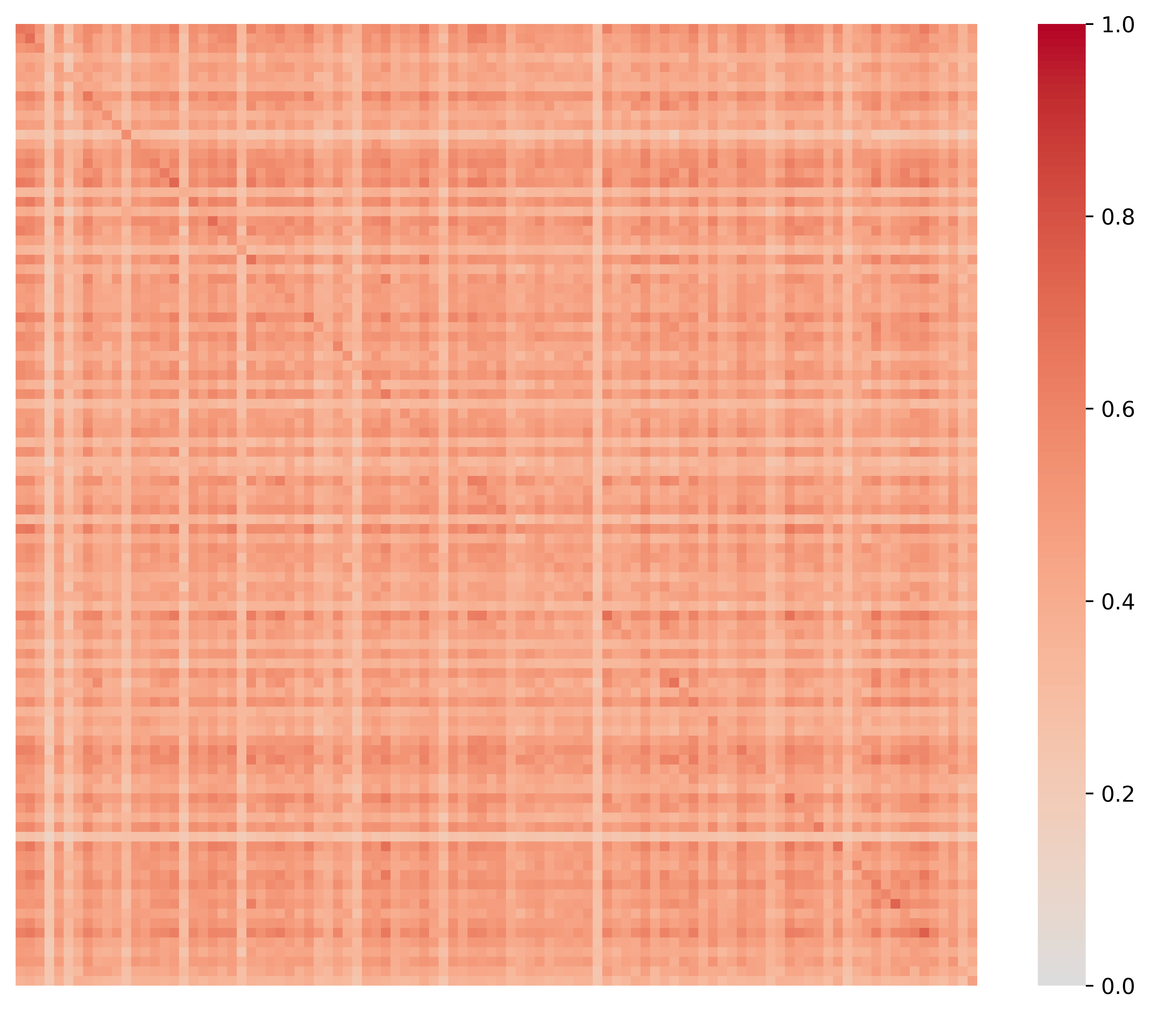
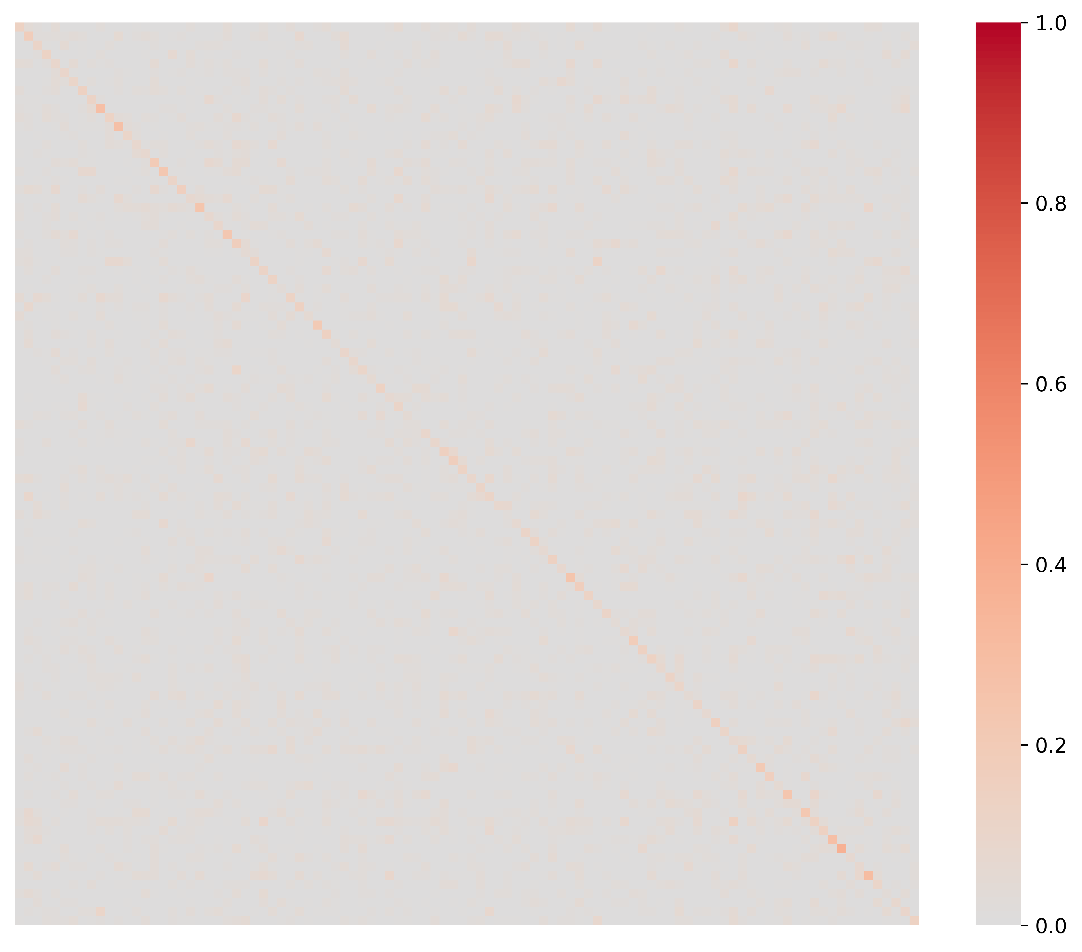

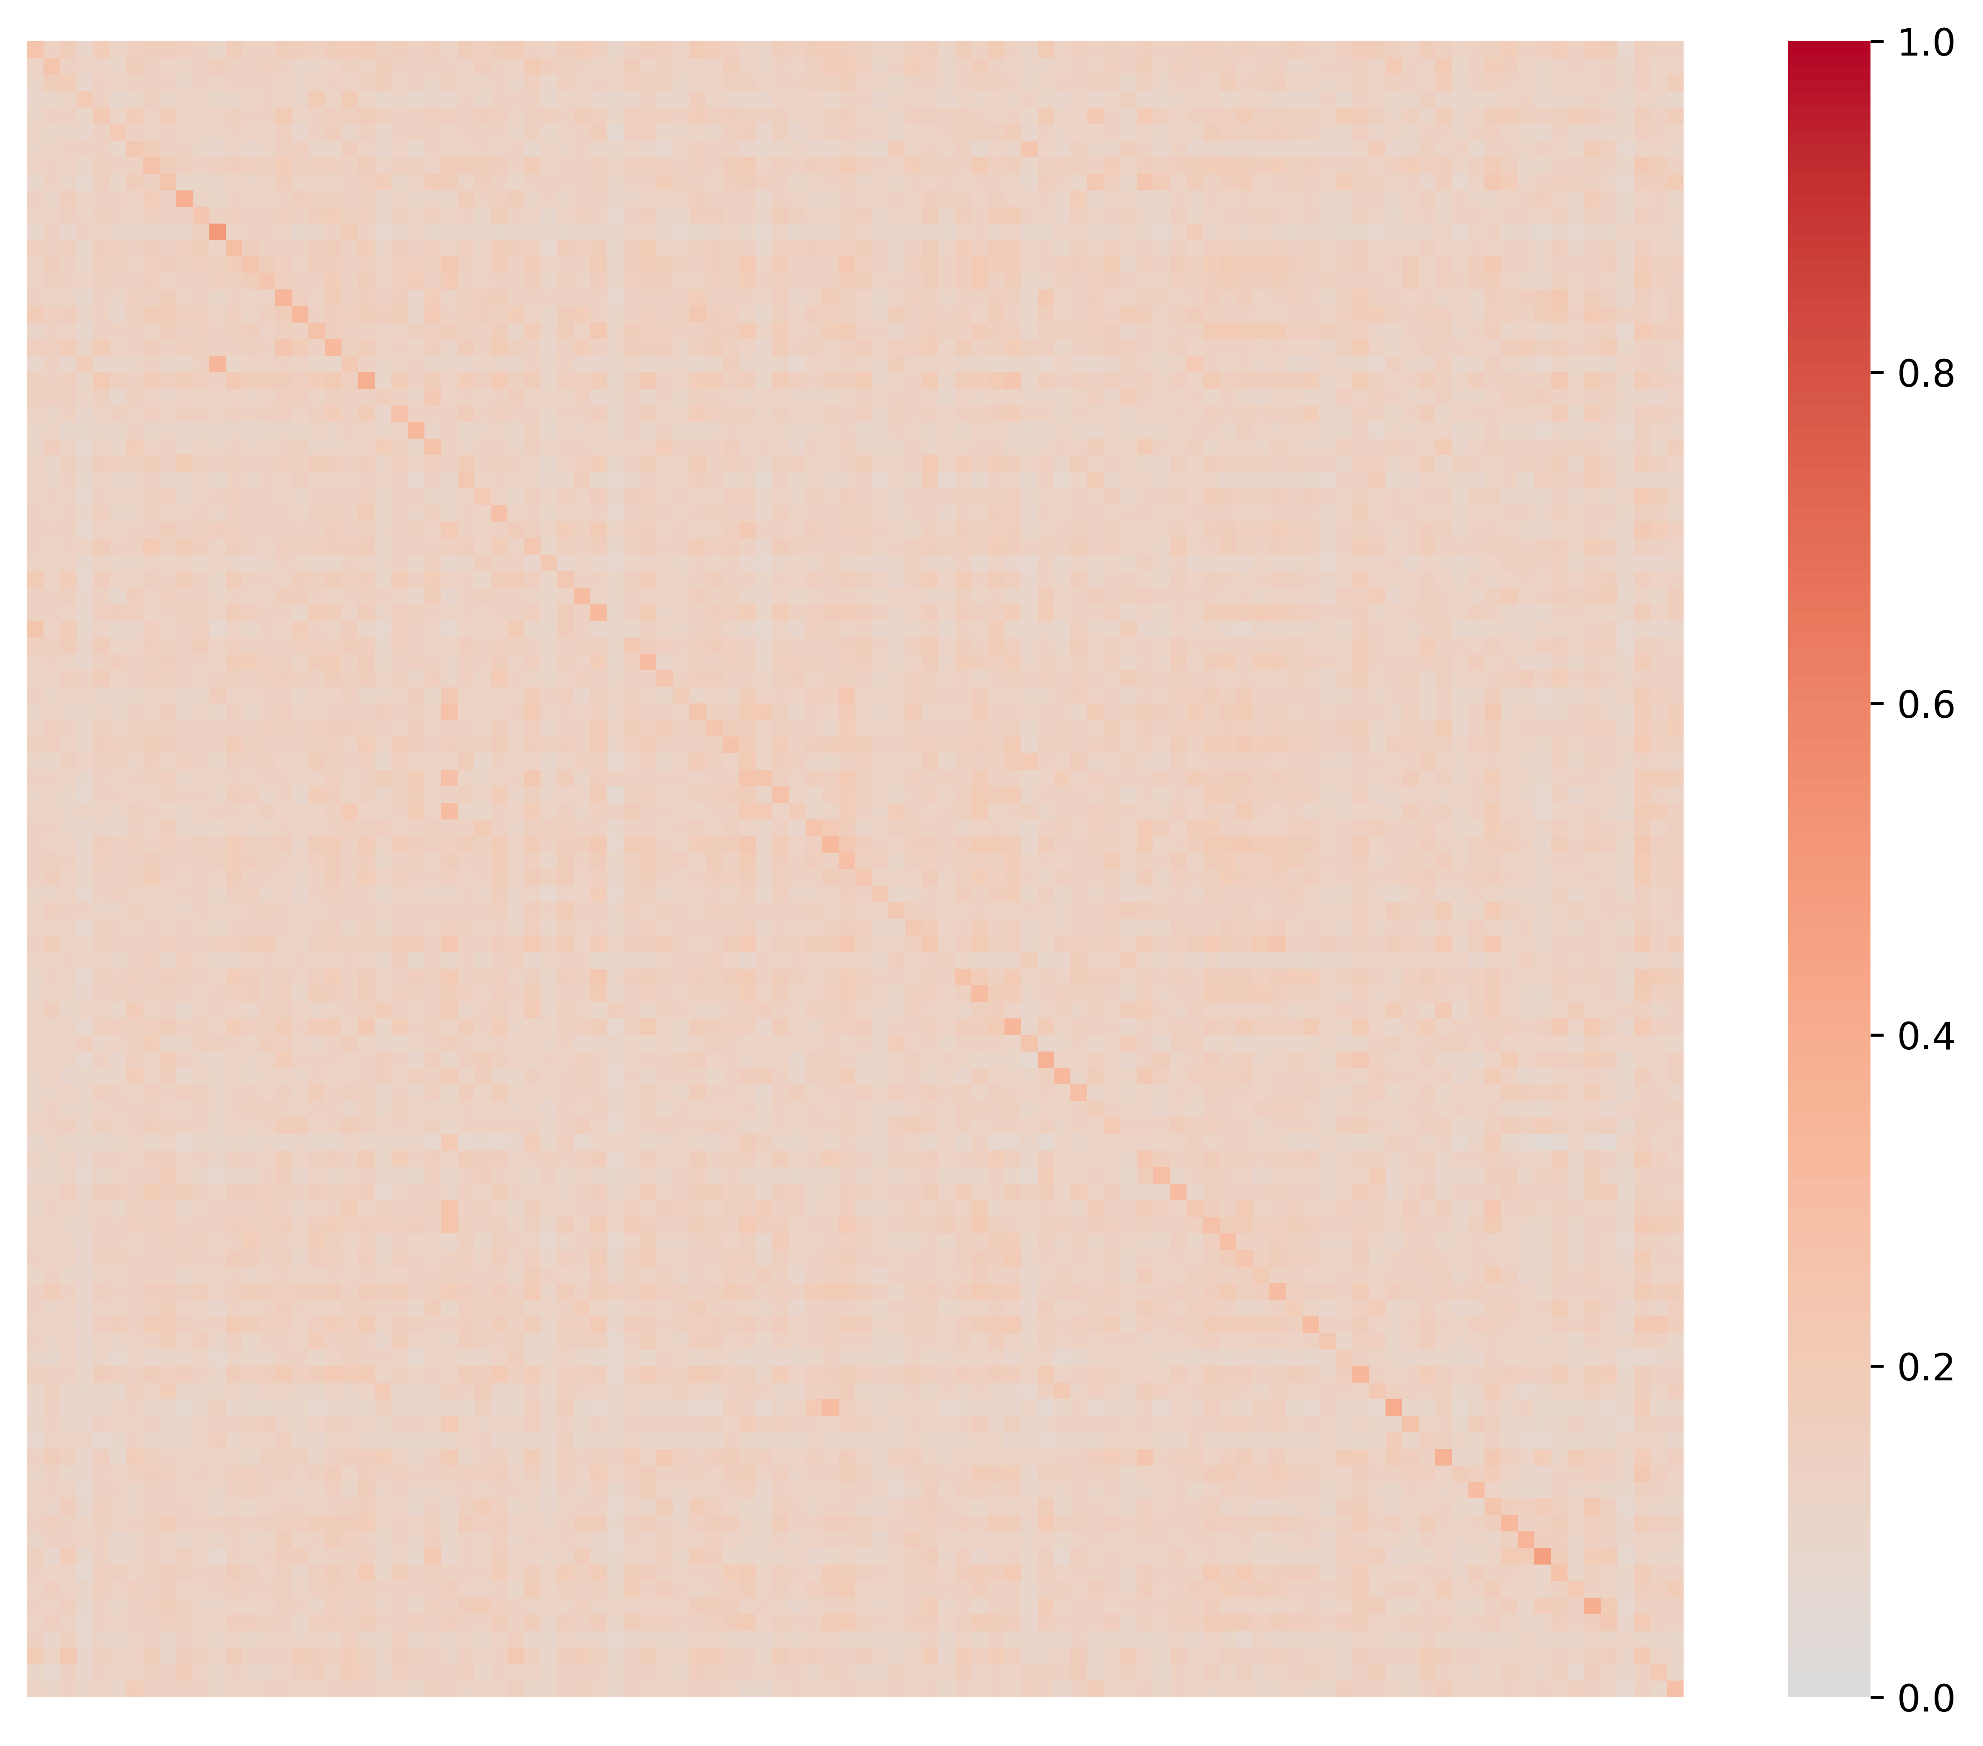
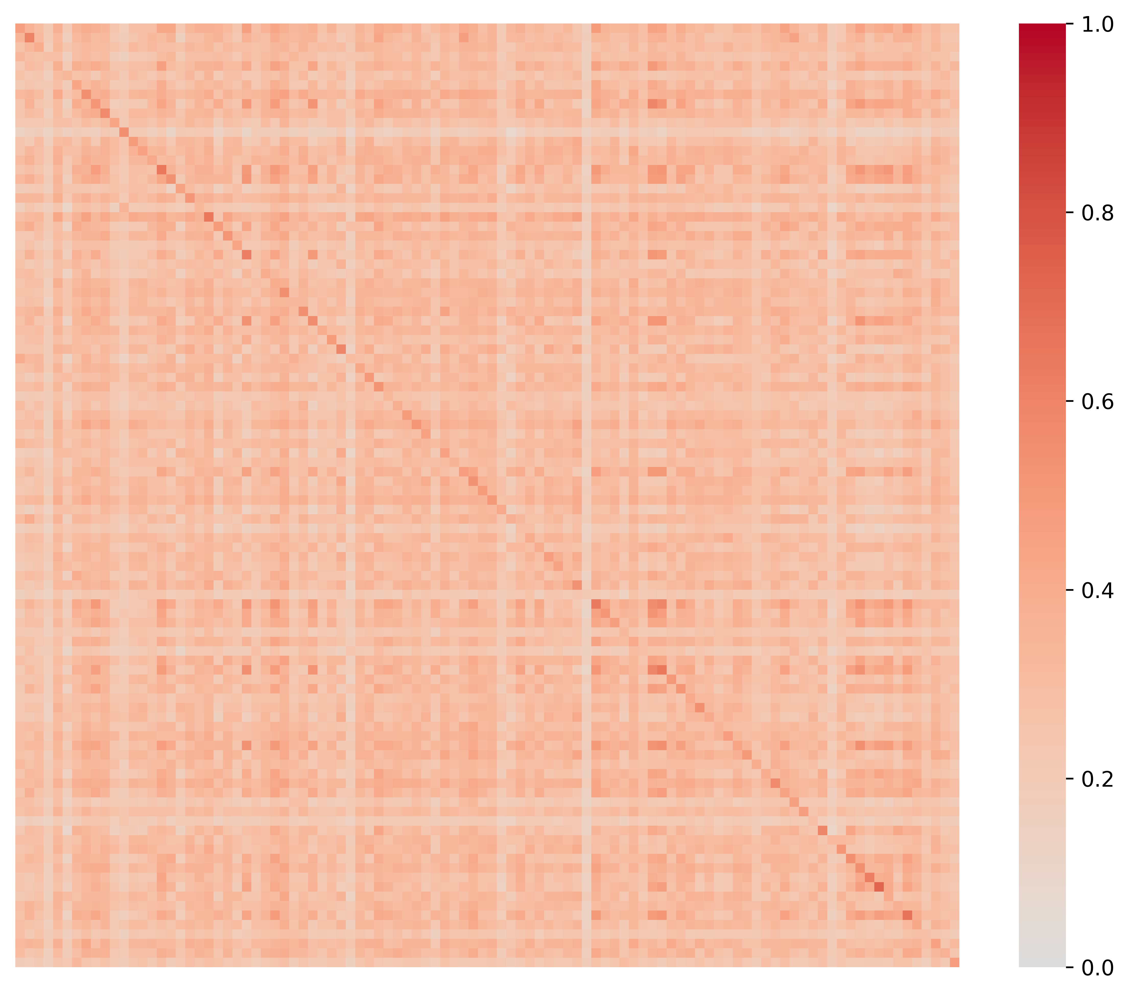
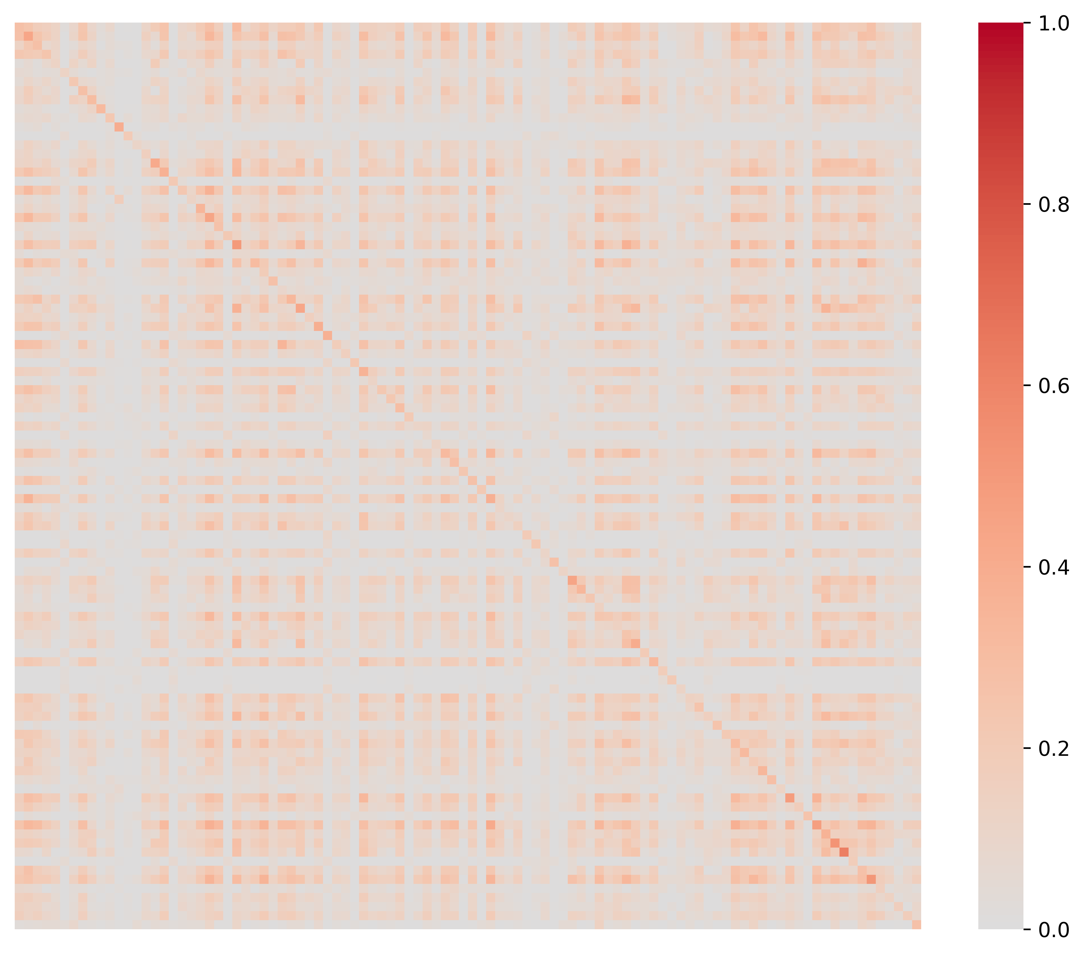
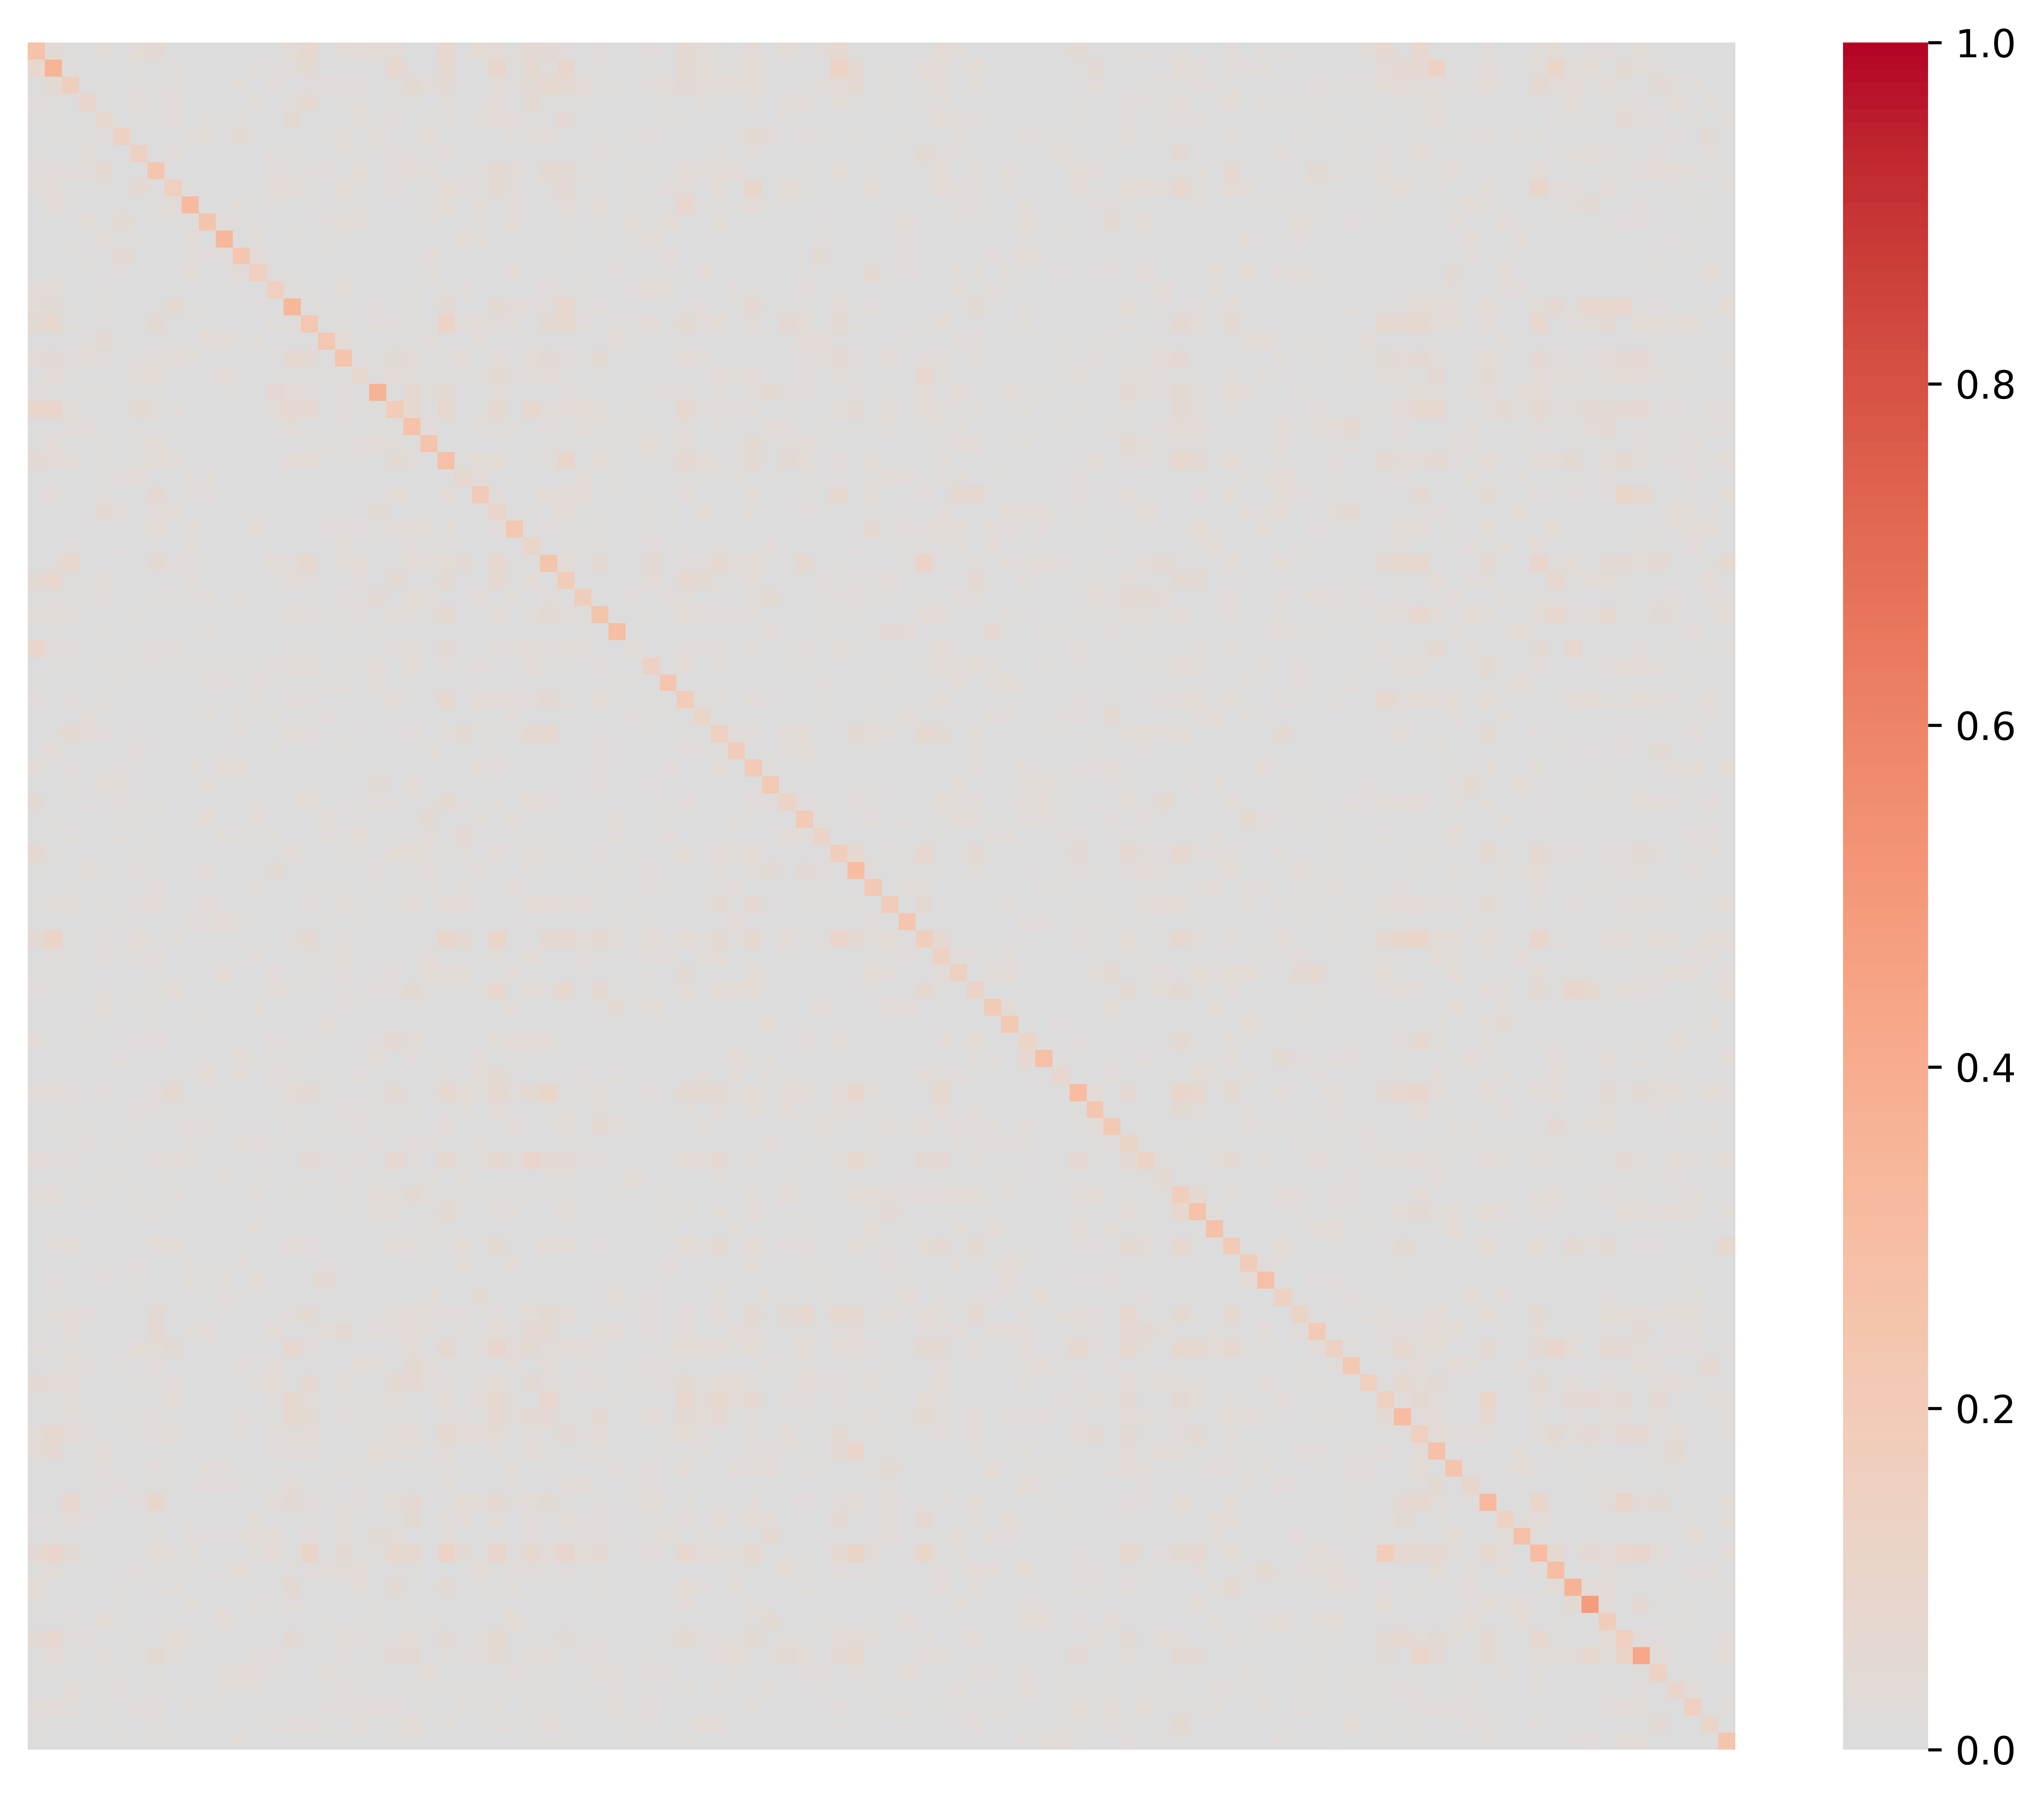
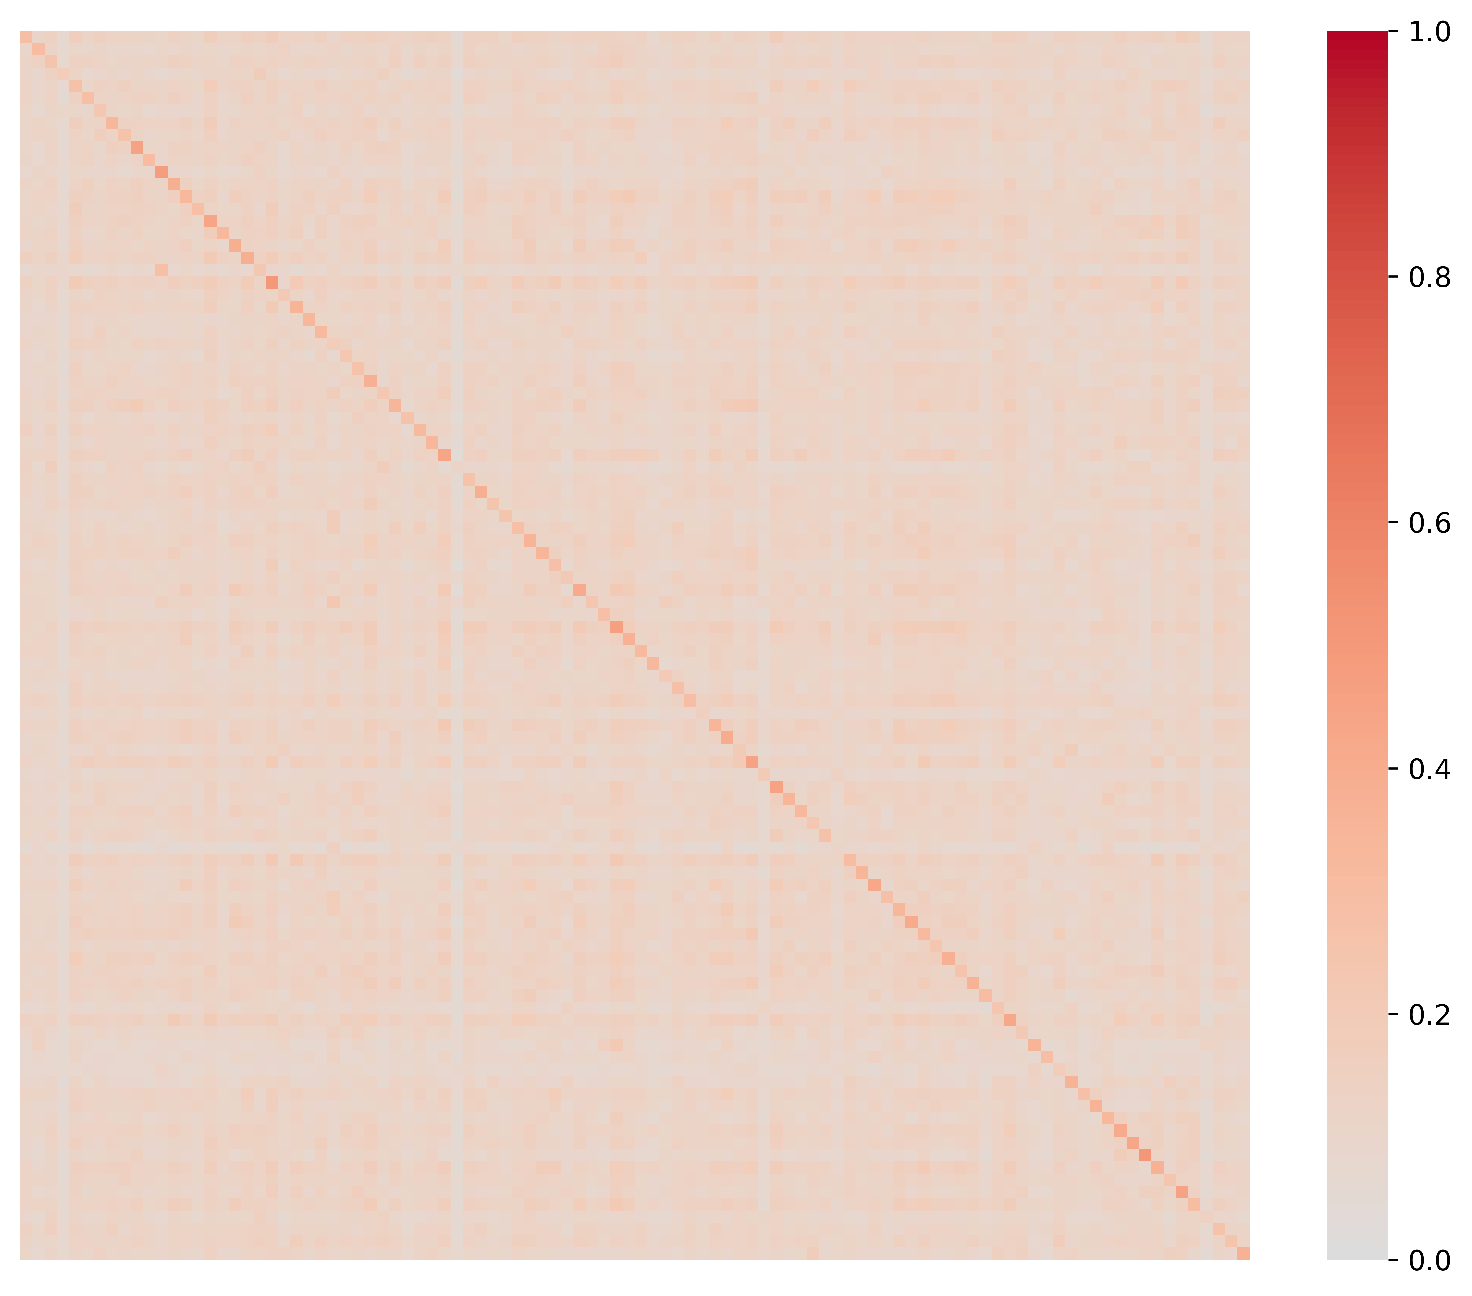

a\
(a) PCC, AAL
(b) (Lu et al., 2024), AAL
(c) (Cai et al., 2021), AAL
(d) VarCoNet-V2, AAL
(e) PCC, AICHA
(f) (Lu et al., 2024), AICHA
(g) (Cai et al., 2021), AICHA
(h) VarCoNet-V2, AICHA
(i) (Li et al., 2023)

Slide 16
a\
(a) PCC, AAL
(b) (Lu et al., 2024), AAL
(c) (Cai et al., 2021), AAL
(d) VarCoNet-V2, AAL
(e) PCC, AICHA
(f) (Lu et al., 2024), AICHA
(g) (Cai et al., 2021), AICHA
(h) VarCoNet-V2, AICHA

